Slide 1
Flipping Primary Source Instruction
Classwork at Home
Homework in Class

Slide 2
Dilemma: Too much Information - Not Enough Time
→ 1 hour 15 minutes for my
presentation
→ Topics covered in Lecture
√ Definition
√ Finding Aids
√ Online Catalogs
▪ Controlled Vocabulary
▪ Advanced Search
▪ Browse Search
√ Digitized Material
→ Over 500 students

Slide 3
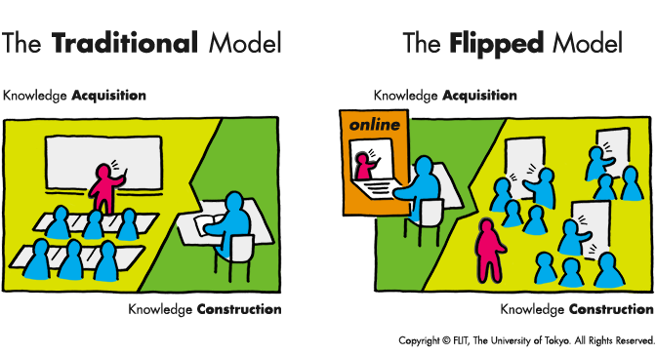
Solution: Flipped Learning
Students watch online tutorials before lecture
Brief discussion of tutorial contents in class
Group activities
Student-lead exercises

Slide 4
Advantages of Flipped Learning
Make the most of the time allotted for
instruction
Maximize success of achieving learning
outcomes
Assessment method for efficacy of pedagogy

Slide 5
Case Study: Spring 2014
METHODOLOGY
Respondent Pool
→ 26 contacts
→ Never used primary sources
Time Line
→ 1 week for pre-tutorial questionnaire
→ 1 week to watch (2) video tutorials
Definition of Primary Sources
Locating Primary Sources on the Internet
→ 1 week for post-tutorial questionnaire

Slide 6
RESULTS OF CASE STUDY: Percentage of Correct Answers
PRE POST
Defining Primary Sources
Select the example of a Primary Source 80% 64.3%
Select the one that is NOT a Primary Source 60% 78.6%
Select the one that is NOT a Secondary Source 26.7% 28.6%
Locating Online Digitized Primary Sources
Select the one that is NOT a way to determine
if a physical document is a forgery or authentic 40% 35.7%
Select the one that DOES NOT need to be considered
when authenticating online Primary Sources 26.7% 14.3%
Select the one that is NOT a method of locating
Primary Sources on the Internet 80% 35.7%

Slide 7
Analysis of Results
Lessons Learned
Future Endeavors
All concepts are equally complex
Many participants struggled to translate theory into application
Hands-on activities required
More than 1 hour 15 minutes is still required
ASIDE:
Study up on the best methods to create questionnaires/surveys
Create more videos to address all topics in depth
Instruction that incorporates critical thinking skills
Design interactive “Tutorials,” not reactive “Instructional Videos”
Lobby University to create a (1) or (3) credit course

Slide 8
Flipped Learning in Action: Fall 2014
Creation of (6) videos
Example: Finding Aids Tutorial
Collaboration with instructors to customize “classwork” and “homework”
Group activities
Hands-on searching strategies to locate primary sources for their research topics

Slide 9
Contact Information
Julie Thomas
Special Collections & Manuscripts Librarian
California State University, Sacramento
(916) 278-5240
jthomas1@csus.edu

