Slide 1
Session 4: Technology and Archives –
Exchange Forum - Programmer & Archivist Collaboration
Kim Klausner
Industry Documents Digital Library - Manager
University of California, San Francisco
Kim.Klausner@ucsf.edu
Sven Maier
Industry Document Digital Library - Software Engineer
University of California, San Francisco
Sven.Maier@ucsf.edu
9 May 2014

Slide 2
Legacy Tobacco Documents Library http://legacy.library.ucsf.edu

Slide 3
Industry Documents Digital Library
Drug Industry Document Archive – DIDA
http://dida.library.ucsf.edu
Food Industry Document Archive – FIDA
To be created
Portal to search single or multiple industries
New Software - SOLR, BlackLight, Grails, HTML5
Staff
Programmers: 1.5 back-end, 1 middle-tier, 1 front end
User Experience designer
Archives/admin: 2.5 FTE

Slide 4
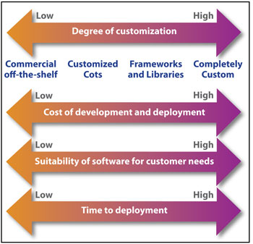
Commercial Off The Shelf (COTS) vs. Custom Build
Frameworks/Libraries – good solution for us
2. We had money for the project!
Our users have very particular search needs to weed through 14 million documents
1.
3. No time constraints

Slide 5
Software Development
For-profit Sector
Dedicated resources for each stage
Common background/expertise
Library / Academia
Limited resources
Small Team

Slide 6
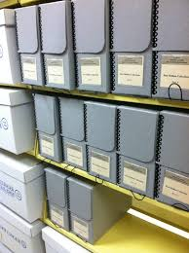
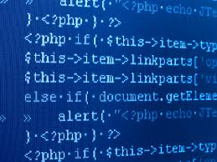
Communication Gap
Build us a PDF viewer
I am not Adobe
You want me to do what?
It’s going to take you how long to do that?
What exactly do you want?
You can’t just take it out?
File a bug?

Slide 7
As an archivist I had to learn
Software Development Project Manager
Development cycle
Researchers motivate design & functionality
Functional Specs – Technical Specs
Programmer estimates time needed
Front end & back end
QA – try to break it
Bugtracker

Slide 8
As a programmer I had to learn
To take part in the design and specification process
Take part in the QA process - usually not a good idea
Work very independently w/o being able to bounce ideas off other peers

Slide 9
Tips for programmers
Be human - Technical terms and processes can be intimidating - Remember how it feels to be out of your element.
Do not talk code - Avoid going into to much detail – code etc. - Explain processes from the user point of view - Describe the results rather then the process of
Learn your counterparts domain - Gives you a better understanding as to why a customer request certain features

Slide 10
Tools that help us
WIKI
Gathering requirements, Brain Storming,
Technical notes, Specs.
Redmine - A flexible project management tool (Bugtracker , Feature Tracker , GANTT charts )
Instant Messaging Being able to communicate right away when an issue arises

Slide 11
THANK YOU
http://legacy.library.ucsf.edu
Kim Klausner
Kim.Klausner@ucsf.edu
Sven Maier
Sven.Maier@ucsf.edu

