Slide 1
What the Hell is It and What Do I Do with It: Cataloging Challenging Collections
The Stephen M. Cabrinety Collection in the History of Microcomputing, ca. 1975-1995
Society of California Archivists AGM: May 10, 2014 8:30am-10:00am
Charlotte C. Thai Cabrinety Project Assistant

Slide 2
Introduction
Agenda
Part I: Background Information
Who I am
Cabrinety Collection
Stephen M. Cabrinety
Cabrinety-NIST Project
Part II: Project Challenges
Notes:
This presentation is divided into two sections. The first part provides background information about myself, the Cabrinety collection, and the Cabrinety-NIST Project. This is a grant-funded project where the collection is being used in a large-scale digital preservation effort. The second part will focus on the challenges that have arisen during the project.

Slide 3
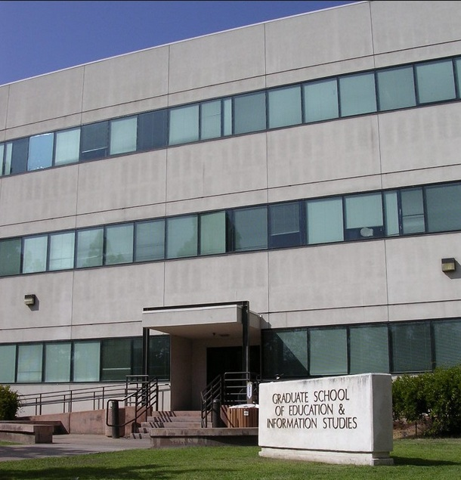
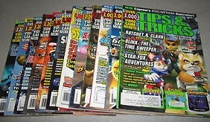
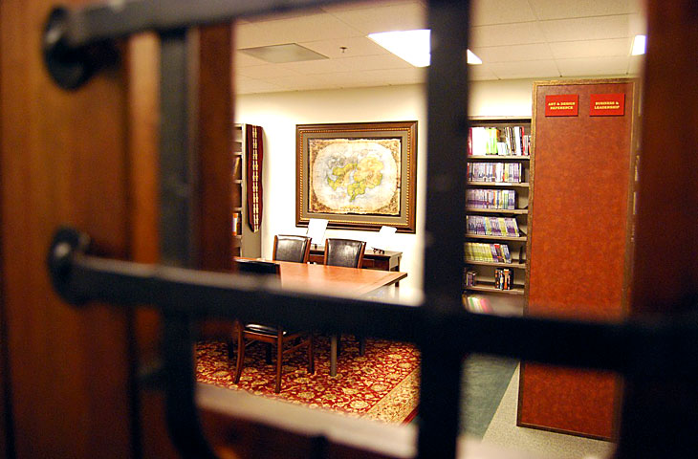
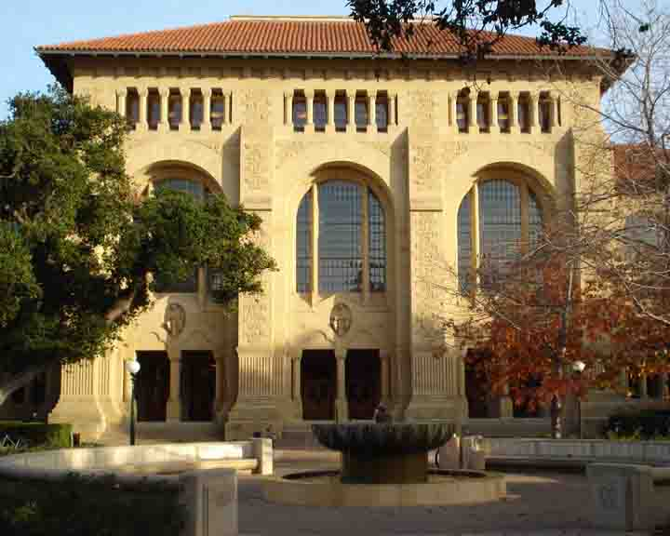
Who I am
Notes:
My first career was in video game journalism, where I worked for a strategy guide magazine called Tips & Tricks for almost 8 years. Now the only place you can find this magazine is in the storage rooms of myself and my former colleagues, or on ebay. After the magazine was killed, I became interested in videogame preservation, so I changed career tracks and got my MLIS at UCLA in 2010. After I graduated, I worked for a short time at Blizzard Entertainment – the lower left is a shot of the Blizzard Library, which operates on their office campus like a public library for their employees. Finally, I joined Stanford University’s Special Collections Department in 2012 as the Cabrinety Project Assistant.

Slide 4
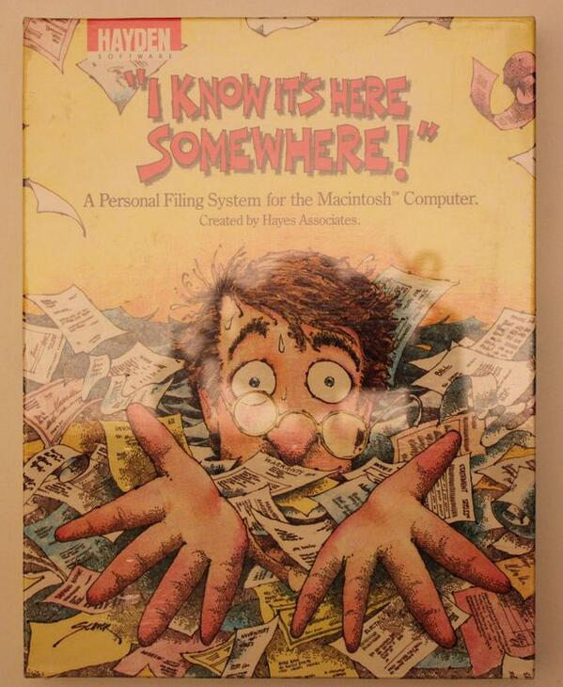
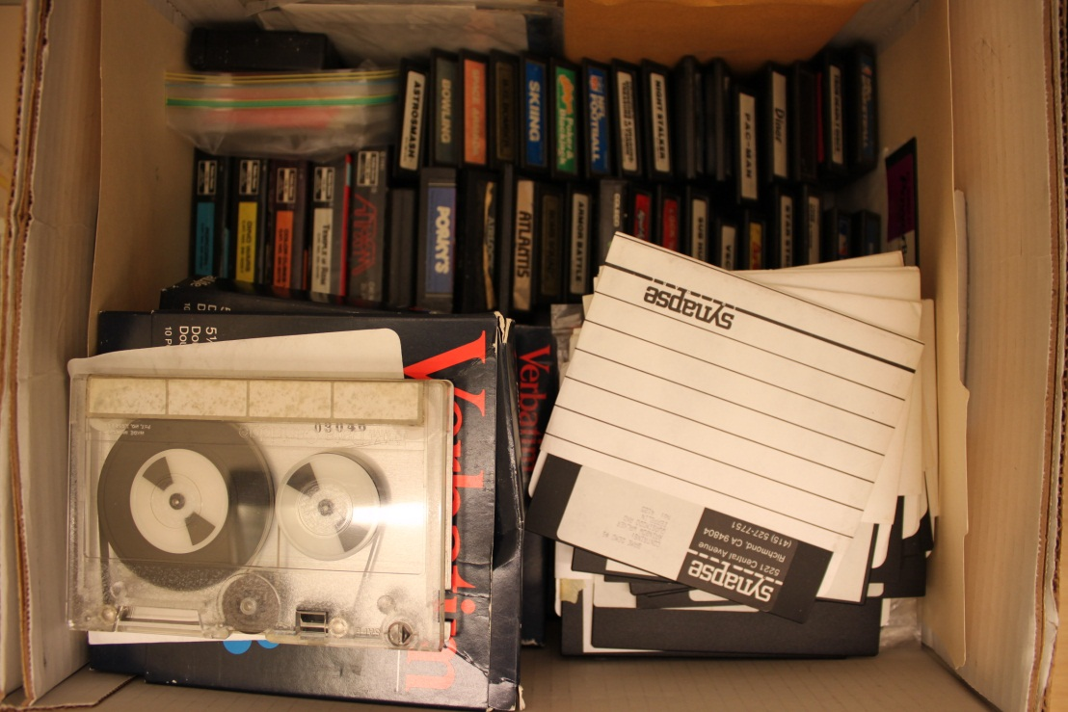
Cabrinety Collection
12,000-15,000 software packages
27 operating systems
400 pieces computer hardware
200 pieces computer-related realia
Documents, ephemera, periodicals
Notes:
The Cabrinety Collection is one of the largest archival collections of historical microcomputing software anywhere in the world. There is 1,375 linear feet of collection material, including software, hardware, documents, and realia. The 12,000-15,000 software packages contain media formats as old as cassette tapes and computer cartridges, to more modern-day formats like the CD-ROM. The software portion of the collection alone is almost 700 linear feet, and although it includes operating systems, utilities, and business applications, the majority of these packages are computer and video games. The box shown contained dozens of loose video game cartridges.

Slide 5
Stephen M. Cabrinety
Notes:
Stephen M. Cabrinety started collecting computer and video games when he was still a teenager. Documents found in the collection show that he decided early on to create a computer museum that could benefit researchers. He collected thousands of pieces of microcomputing hardware and software in pursuit of this goal, but he unfortunately he died in 1995 at the age of 29 due to complications from Hodgkin’s Lymphoma. His family wanted to preserve his collection, and searched for institutions that were already caretakers for other technology archives. His sister found out that Stanford was a caretaker for the Silicon Valley Archives, and she contacted the university. Curator Henry Lowood helped negotiate the transfer of the entire collection by gift in 1998.

Slide 6
NSRL Grant
Cabrinety-NIST Project
What is the grant?
NSRL (National Software Reference Library)
Who are the collaborators and what are their roles?
Stanford University Libraries
Curator of History of Science and Technology; Film and Media Collections
Special Collections, Manuscripts Division
Digital Library Systems & Services
NIST (National Institute of Standards and Technology)
Notes:
The National Software Reference Library is funding a two-year project to fully digitize and migrate into long-term storage the historical software found in the Cabrinety collection. The collaborators at Stanford include the curator who brought in the collection, the Special Collections Department (which manages the physical assets), and Digital Library Systems & Services (which manages the Stanford Digital Repository). NIST (National Institute of Standards and Technology) is a government agency that manages the National Software Reference Library.

Slide 7
National Software Reference Library
Notes:
NIST collaborates with the Department of Homeland Security on the National Software Reference Library to assist law enforcement agencies investigating computer crimes. The National Software Reference Library is a collection of commercial software. NIST computes a checksum for every file in every software package in their collection using a cryptographic hash algorithm. Types of checksums include MD5s and SHA1s – these are fixed length alphanumeric strings that act as file signatures and are used to identify and validate data. Checksums summarize large amounts of data into a small amount of space. Every time the MD5 or SHA1 is calculated for a file, the same checksum should be generated. If there is an alteration in the checksum, it means the file has changed.
Four times a year the National Software Reference Library publishes a Reference Data Set of all the checksums they have generated. This is provided to law enforcement who compare the checksums on seized computers against the Reference Data Set, and anything that matches can be eliminated as benign. This lets law enforcement concentrate only on files that are important as evidence. Checksums for files in the Cabrinety collection will also be added to this dataset.

Slide 8
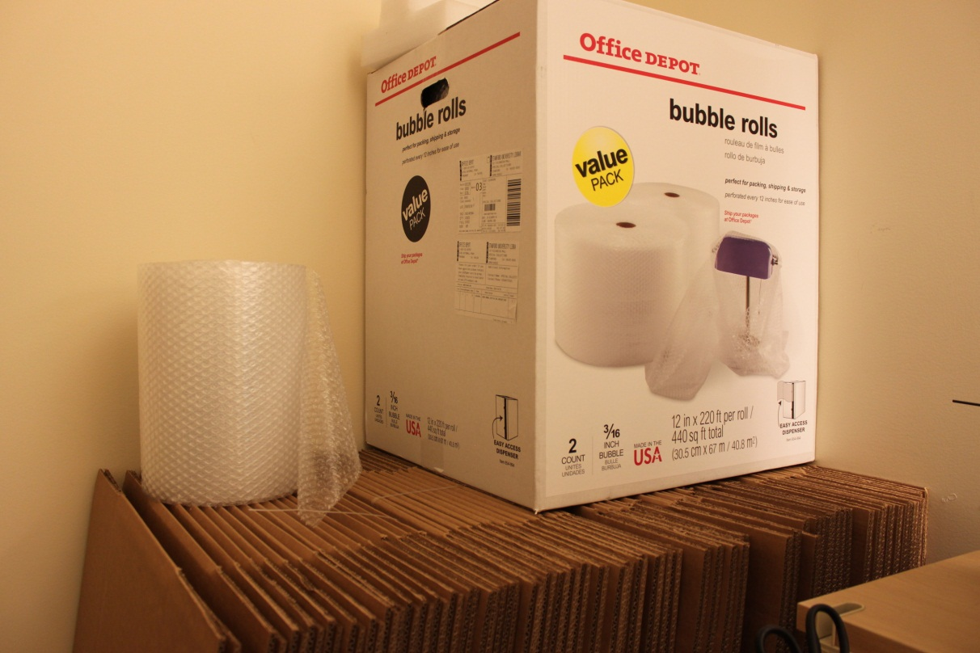
Special Collections, Manuscripts Division
Manage Cabrinety box movements
Physical re-processing of Cabrinety collection
Cabrinety item-level registration in Stanford Digital Repository
Metadata entry and configuration in NSRL Cabrinety database
Quality control on physical and digital items in collection
Notes:
My role as the Cabrinety Project Assistant involves handling the logistics of Cabrinety box movements between multiple departments at Stanford, and shipping the boxes to the NIST facilities in Maryland. It also entails physically re-processing Cabrinety boxes down to the item level, registering Cabrinety titles in the Stanford Digital Repository, and creating skeleton catalog records in a NIST-managed Cabrinety database. When the project ends, I also need to perform quality control on the physical box contents and the digital files and images that are returned to us from NIST.

Slide 9
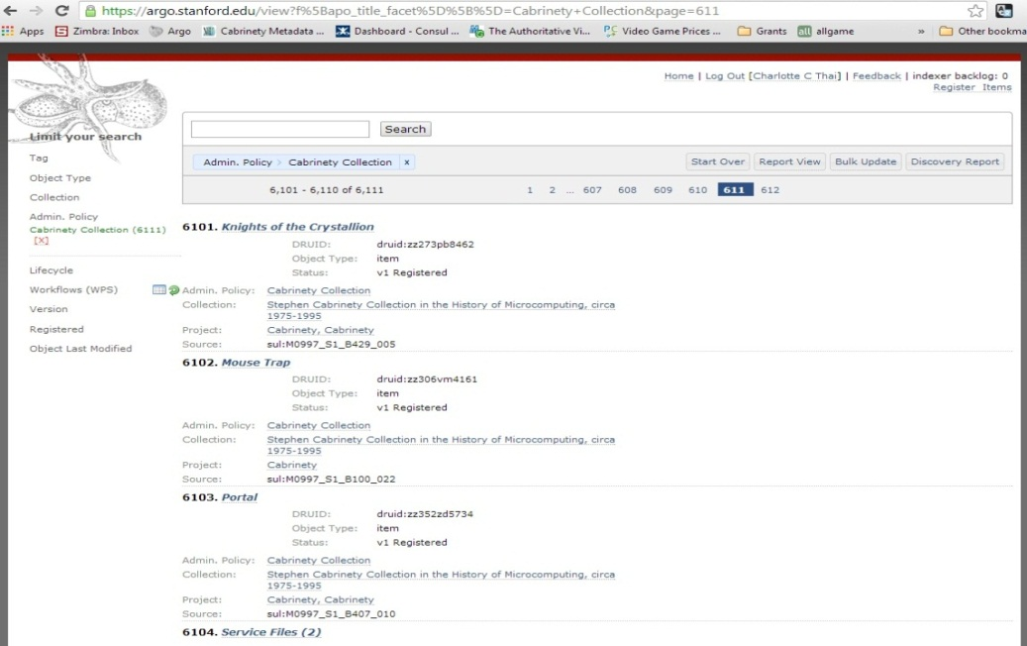
Digital Library Systems & Services
Manages Argo – Administrative interface to the Stanford Digital Repository
Register items with source id, druid, and title
Create tracking sheets
Control accessioning workflow
Provide access to online digital objects through PURLs
Notes:
Stanford’s Digital Library Systems & Services manages Argo, which is an administrative interface to the Stanford Digital Repository. Argo is a Fedora-based service that registers, tracks, accessions, and manages digital assets in order to prepare them for preservation and access. When items are registered they are assigned a 10-digit unique identifier called a “druid.”

Slide 10
Argo: Tracking sheet
Notes:
This is a tracking sheet for the game “Killing Cloud.” Tracking sheets can be downloaded from Argo after registration. It shows the druid at the top, along with a scannable barcode. A tracking sheet is inserted into every software package before it is sent to NIST. Staff there can scan the barcode to easily enter the druid value into their own systems.

Slide 11
Stanford PURL (test)
Metadata
Downloads
Thumbnails
Notes:
Once a software package is digitized, it is accessioned into the Stanford Digital Repository, and can be accessed by PURL (persistent URL). This is an example of a test PURL page for “Shareware International.” The upper right has links to downloadable files such as an error log, a disk image, and the checksum for the disk image. Thumbnail images are shown at the bottom.

Slide 12
NIST (National Institute of Standards and Technology)
Disk imaging
Create disk images and add checksums to NSRL
Provide disk images and checksums back to Stanford
Photographic scanning
Create digital images of all box covers, manuals, inserts, and ephemera at high resolution
Provide digital images to Stanford
Manage the NSRL Cabrinety database
SHA-1 and MD5 Checksums
Notes:
NIST is performing the computer forensics work required for this project. They are creating disk images for every piece of software media, so if a single software package contains eight 3.5” floppy disks, they will generate (or at least attempt to generate) eight disk images. A disk image is a bit-by-bit copy of all the contents of a disk. They will also calculate checksums for each disk image, and all the checksums taken from the Cabrinety collection will be added to the National Software Reference Library’s Reference Data Set. NIST is also digitizing box covers, scanning manuals cover to cover, and photographing other objects such as inserts, realia, or ephemera at high resolution. These disk images and photographic images are returned to Stanford by external hard drive.

Slide 13
NSRL Cabrinety database
Notes:
Item view.

Slide 14
NSRL Cabrinety database
Notes:
Metadata configuration page. This is the last page of Part I of the presentation. The next section will focus on specific project challenges.

Slide 15
Part II: Project Challenges
Level I: Collection Challenge
Level II: Series Challenge
Level III: Item Challenge
Level IV: Metadata Challenge
Level V: Data Challenge
Level VI: Access Challenge
Bonus Level
Notes:
The Cabrinety Project involves working with a large archival games collection, so I’ve divided this section into levels (like in a videogame). And like all good videogames, we’ll have a bonus level.

Slide 16
Level I: Collection Challenge
Storage
Stanford Auxiliary Library 3 (SAL3)
Transportation
Leg 1: SAL3 -> Stanford (40.2 miles)
Leg 2: Stanford -> NIST (2,827 miles)
Leg 3: NIST -> Stanford (2, 827 miles)
Leg 4: Stanford -> SAL3 (40.2 miles)
Total distance each box travels: 5733.6 miles
Notes:
When materials from SAL3 are needed on campus at Stanford, they need to be paged for delivery.

Slide 17
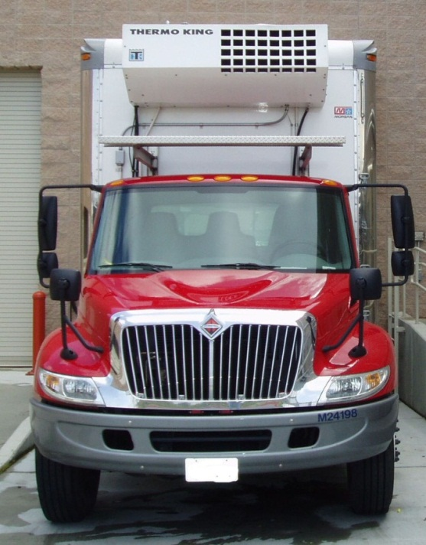
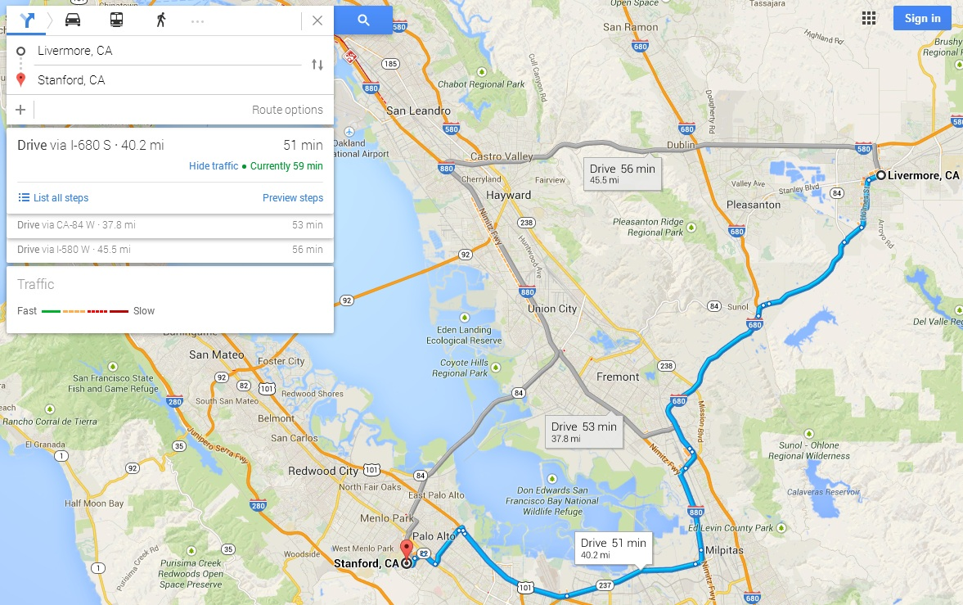
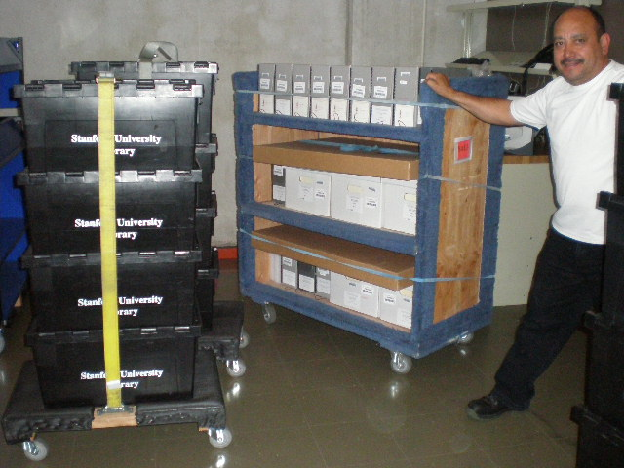
Transportation and Tracking SAL3 to Stanford Campus
Notes:
Every day, SAL3 drives a truck from Livermore to Stanford with paged materials that are distributed throughout campus. The Cabrinety Collection is paged the same way.

Slide 18
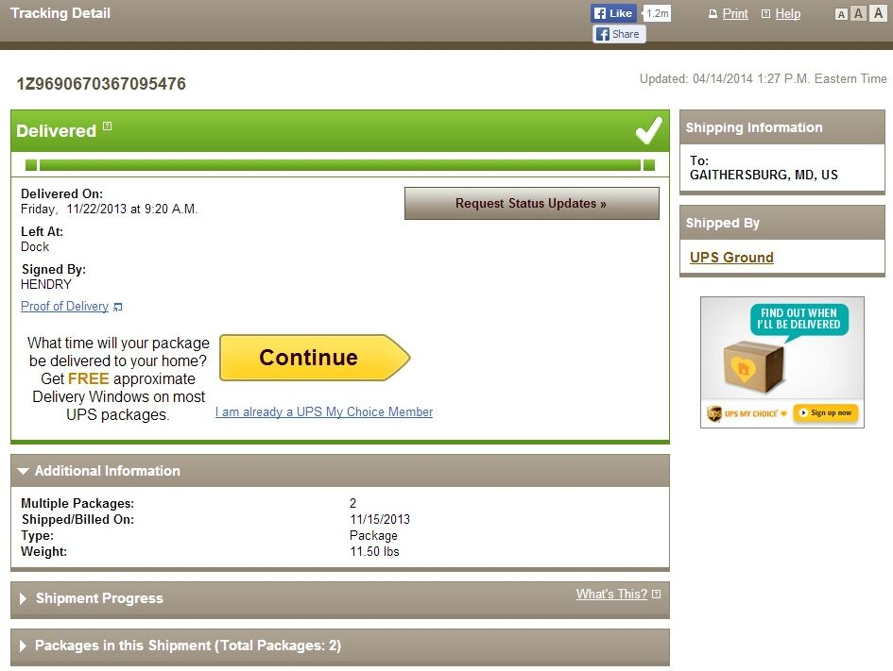
Transportation and Tracking Stanford to NIST
Notes:
We are using UPS to ship boxes to NIST. In order to mitigate risk, UPS sends tracking emails to staff at Stanford and at NIST.

Slide 19
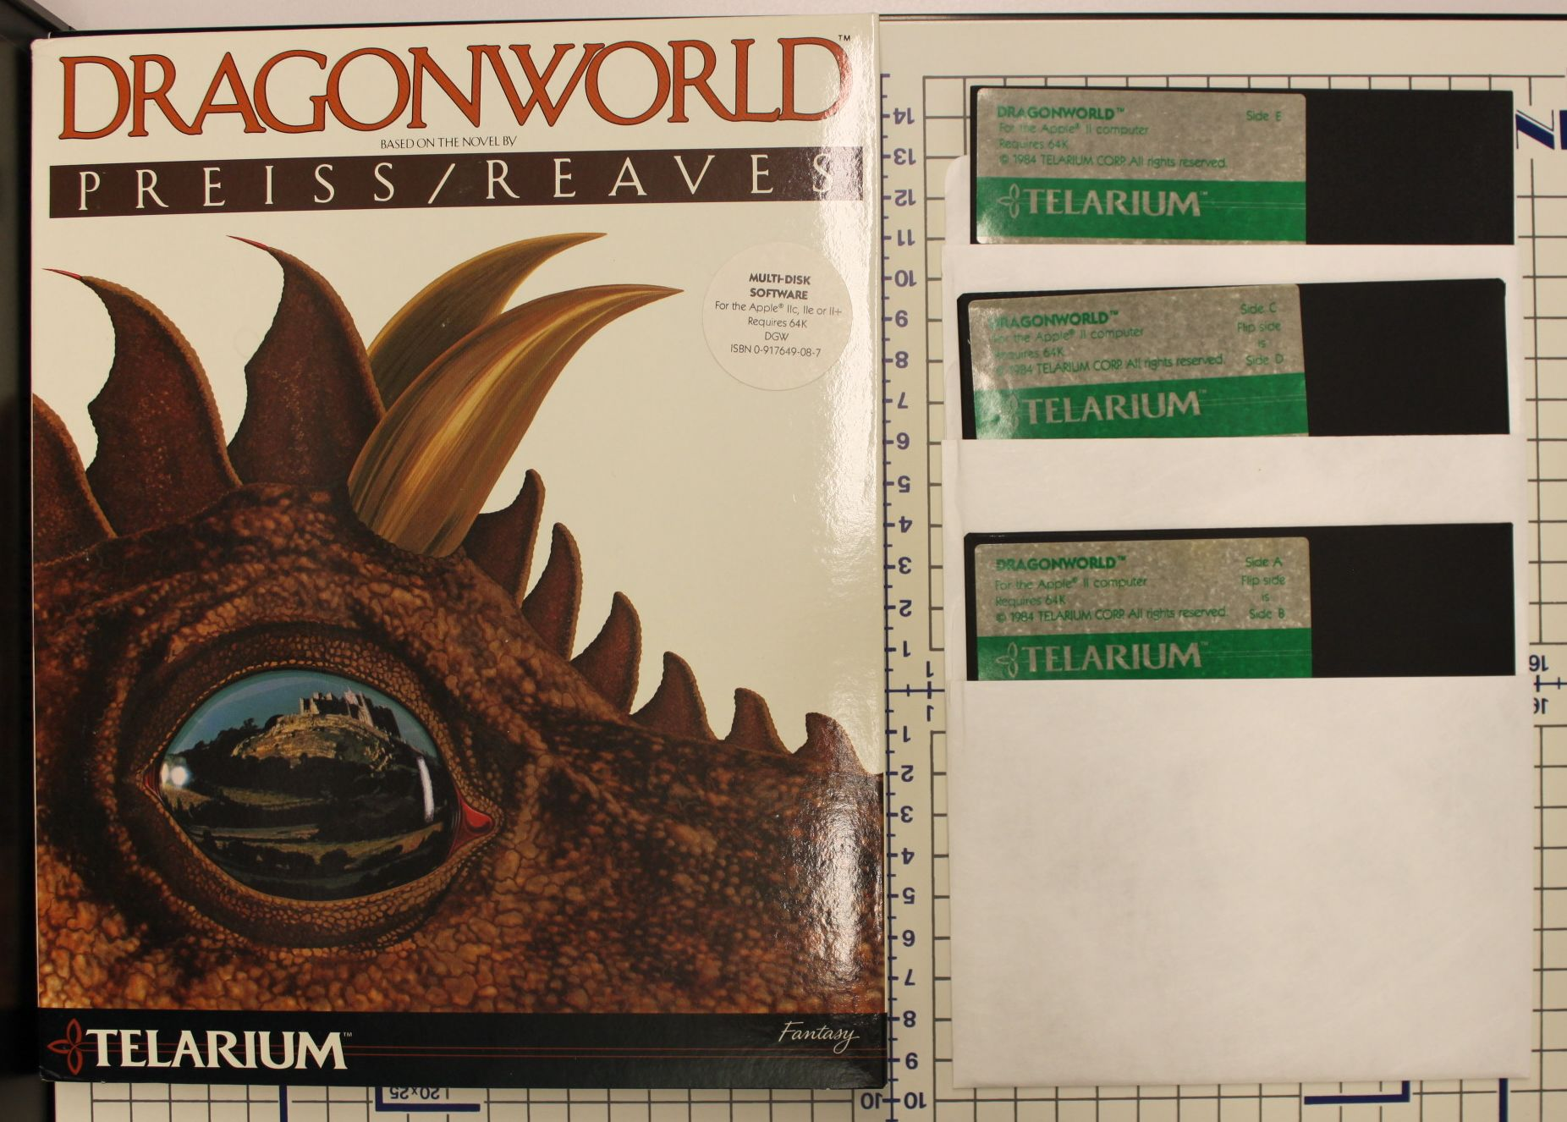
Photo Reference
Notes:
Prior to shipping anything to NIST, I take reference photos. These are reference photos so do not need to be high quality. They are to show the title and the physical quantity of media that were in the software package. In case anything happens to the Cabrinety box during UPS transit, we’ll be able to know what was in it.

Slide 20
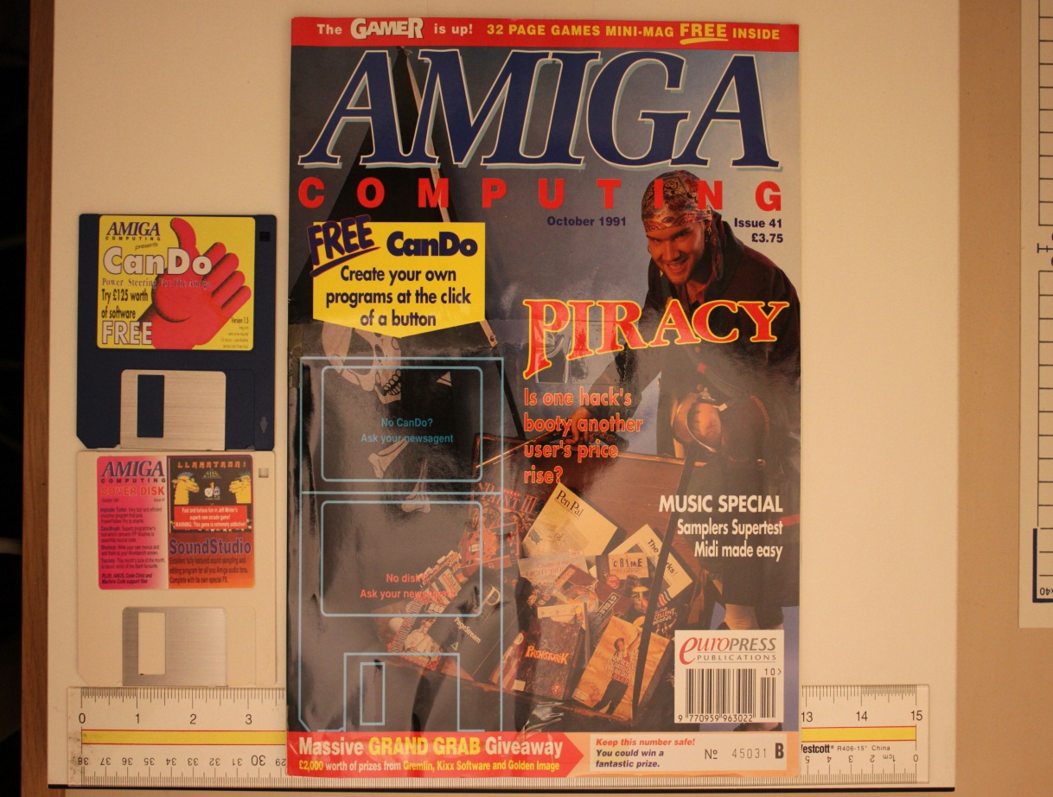
Level II: Series Challenge
Print magazines bound with media
Notes:
Several of the Cabrinety boxes contained mixed series. For example, in the Cabrinety Collection software is marked as Series 1, while periodicals are marked as Series 5. So what should I do when I find a magazine that has software literally glued to its cover? I chose to remove the disks from the cover because we want NIST to create disk images, which they won’t be able to do without reading the disks. Since the data is more important than the physical item, the potential for damage to the magazine cover is not a deterrent.

Slide 21
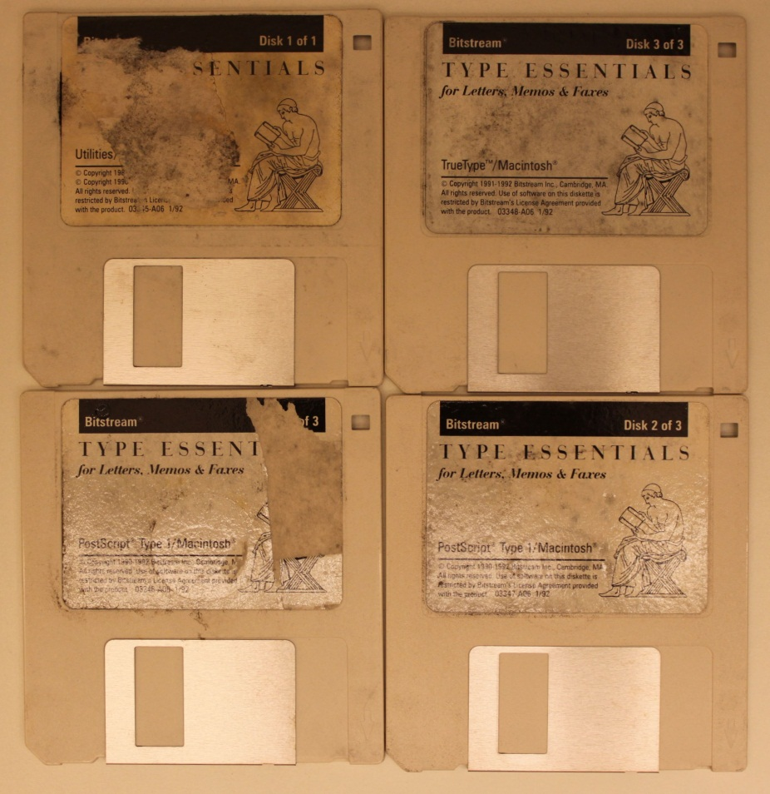
Level III: Item Challenge
MOLD
Still in shrinkwrap
Notes:
This package is Bitstream Type Essentials for Letters, Memos, & Faxes. The black mold covering the box is contained within the shrinkwrap that is still on the package. Despite being in a Cabrinety box with other software packages, the mold did not contaminate anything else. Since the mold grew beneath the shrinkwrap, the moisture probably got into it at the original factory.

Slide 22
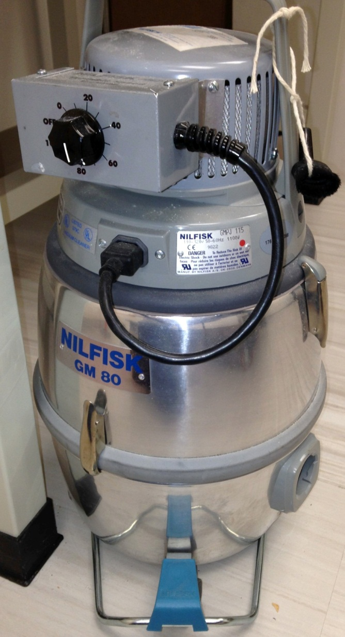
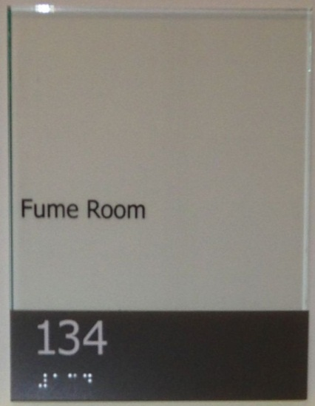
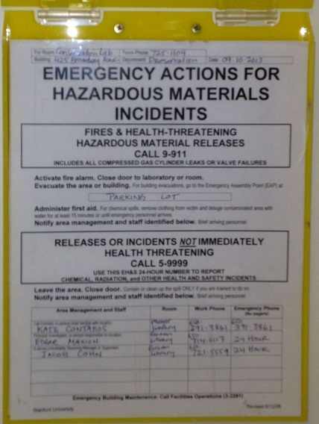
Conservation
Fume Hood
Vacuum
Notes:
I showed the moldy package to the conservation department, and their first reaction was that since it was a commercial software package, it was probably easily replaced. However, this is not the case. I have not found this exact package anywhere online (ebay, Yahoo!), and I have not found it elsewhere in the Cabrinety collection. Bitstream is also an important company, as it was one of the very first digital foundries, which helped popularize desktop publishing through the democratization of typography. The curator was contacted and the decision was made to try and salvage the item if possible. The package was opened under a fume hood, and the disks were vacuumed. Unfortunately, the disks could not be read, and ultimately this item had to be deaccessioned. As a precaution, the items in the original Cabrinety box were moved into a new box, and the old box was destroyed.

Slide 23
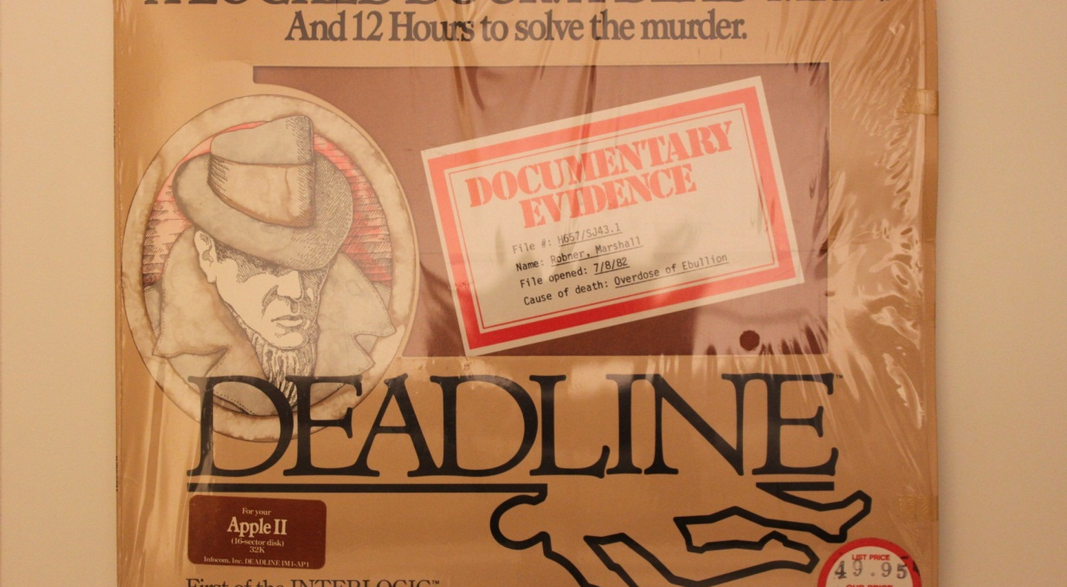
Feelies
Infocom, Inc.
Game publisher
Text adventures
“Feelies”
Extra content
Copy protection
Notes:
Infocom is well-known as a publisher of text adventures, also known as interactive fiction. This is a genre of videogame which is played by writing simple commands that the computer will respond to with prepared text, letting a story unfold. “Deadline” is a murder mystery that used so much text that all of the information could not fit on a floppy with 80K of disk space. To include the extra details that couldn’t fit on the disk, Infocom created “feelies,” physical items that were inserted in the game packaging. These were high quality items that also had a side effect of being a piracy deterrent, as they were difficult to copy, and they also contained vital clues that were necessary in order to solve the mystery in the game.

Slide 24
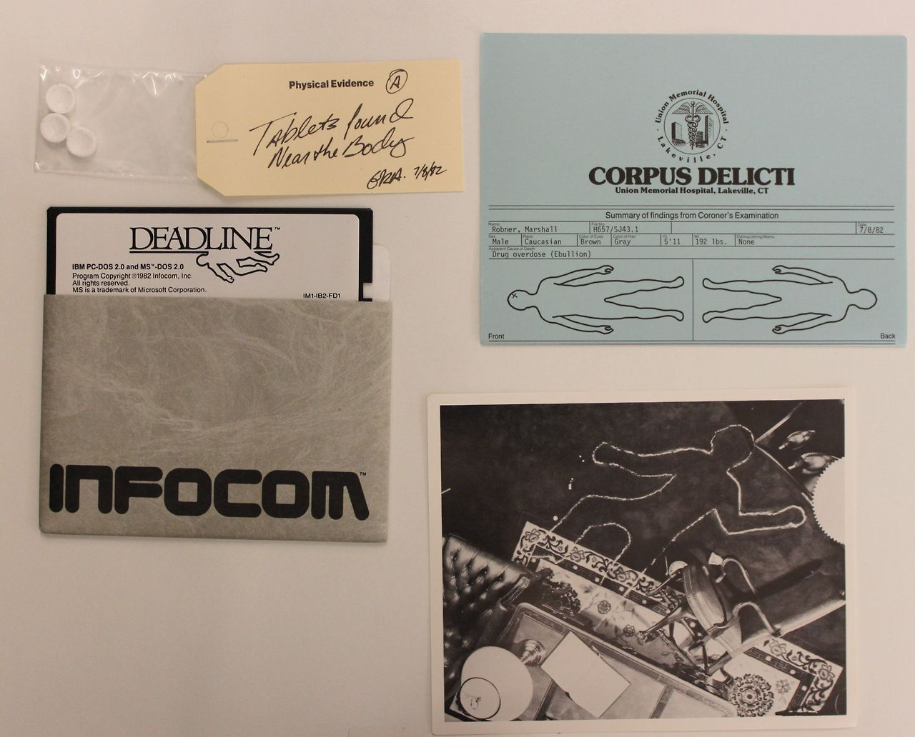
Deadline
Notes:
The problem with the “Deadline” feelies is that one of them was a small bag containing three pills. These were actually breath mints. Since we don’t want to keep any food in the Stanford archives, these needed to be deaccessioned. I photographed the breath mints at high resolution, and printed a color copy of the photograph. The breath mints in the bag were disposed, and the color copy of the photograph was inserted into the package, along with a label indicating the title of the game, the source id and druid for the software package, and the date when the item was removed.

Slide 25
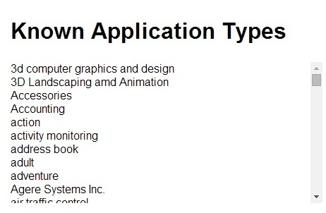
Level IV: Metadata Challenge
Cabrinety-NIST Metadata Stats
5757 file extensions
783 operating systems
600+ application types listed
3807 manufacturers
Notes:
The available metadata standards and authority records are insufficient to meet the needs of computer and video games. In the Cabrinety database, a list of “Known Application Types” operates as a type/genre subject listing with more than 600+ terms. NIST is working on a taxonomy to streamline this section, but the work hasn’t been completed yet. As a result, almost all of the metadata is being created on the fly as I find new manufacturers, operating systems, or genre types and add them to the database myself.
On the right are some of the statistics that have come out so far from the Cabrinety-NIST project. The column shows a list of file extensions that were discovered in the software media that have been processed so far. I could not fit the entire column on the slide because it contains 5757 rows of unique file extensions.

Slide 26
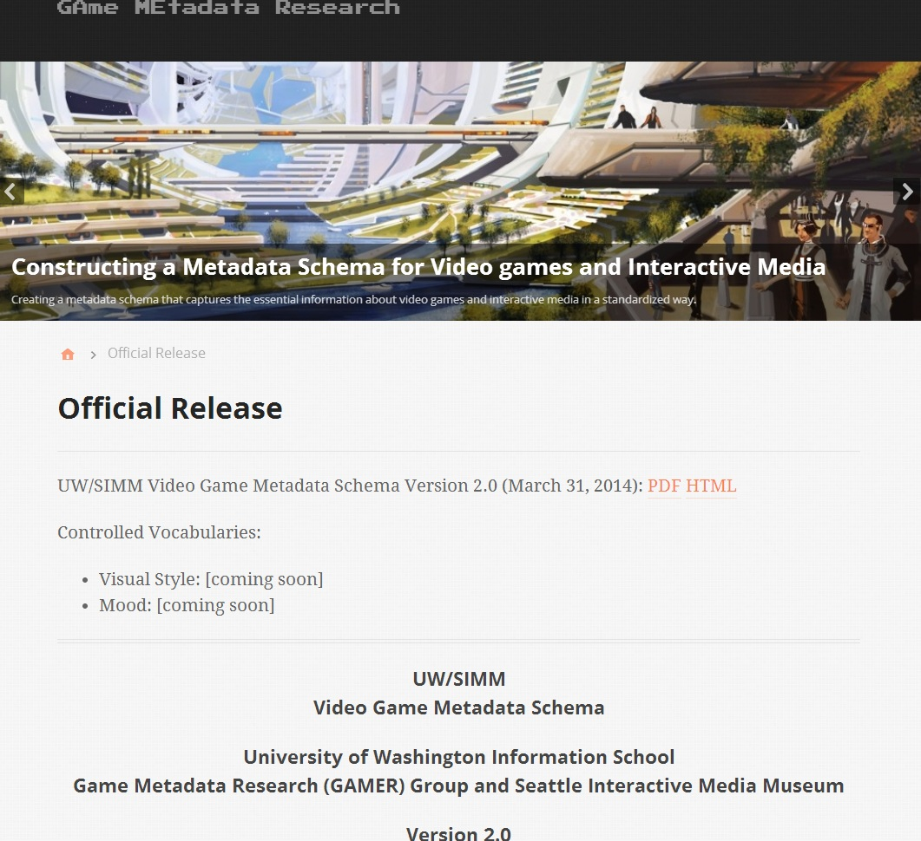
Video Game Metadata Schemas in Development
University of Washington
SIMM (Seattle Interactive Media Museum)
IMLS Grant: GAMECIP
UC Santa Cruz
Stanford University
Notes:
The metadata problem is being addressed at an institutional level. The University of Washington, in partnership with the Seattle Interactive Media Museum, is working to create a video game metadata schema. They released Version 2.0 of their schema this past March.
UC Santa Cruz, in partnership with Stanford Univeristy Libraries, is also planning to publish a metadata scheme for video games, with a focus on discovery and citation. This project is funded by the IMLS and is in the first year of a three-year grant.

Slide 27
Level V: Data Challenge
How is the data captured from cartridge media?
Notes:
Some of you may remember these games from your childhood. Super Mario Kart for the SNES?
NIST is responsible for creating disk images off the software found in the Cabrinety collection, but what can they do with video game cartridges? This is an image of the Retrode, a USB-adapter that can be connected to a personal computer. The Retrode comes with two cartridge slots, one for a Super Nintendo cartridge, and one for a Sega Genesis cartridge. The Retrode reads the game data off the cartridge and creates a ROM image on your computer. ROM=read-only memory. If you have an emulator program on your computer, you can use it to open the ROM image and play the game on your computer. The Retrode even comes with connectors that work with the original Super Nintendo and Sega Genesis controllers.

Slide 28
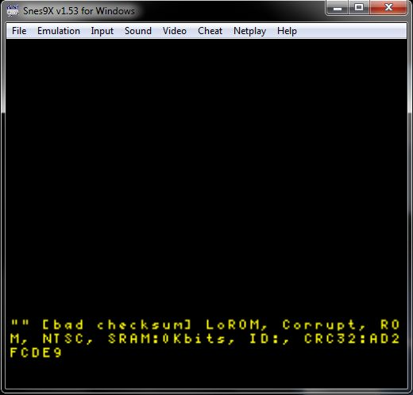
Checksums
http://www.stanford.edu/group/htgg/cgi-bin/drupal/?q=node/1179
Notes:
One of the interns at NIST experimented with the Retrode and found that there was some inconsistency in the ROM images. He would get a ROM image from the cartridge, but whenever he calculated the SHA-1, the checksums would be different. This meant there were slight variations between the ROM images, and SHA-1 checksums could not be used to validate the data integrity.
In order to determine if a ROM image was “good” or “bad” a different calculation other than the one for the SHA-1 checksum had to be performed. The intern knew that every cartridge contained metadata that was stored in something called the “ROM Header.” One of the key pieces of information stored in the ROM Header is a unique checksum. Every company uses a proprietary algorithm to calculate this checksum. He discovered the algorithm used for Super Nintendo and for Sega Genesis games. Once he calculated the checksum using the company algorithm, it could be compared to the checksum found in the “ROM Header” metadata to see if it was a “good” ROM.
He wrote a guest post for Stanford’s “How They Got Game” blog in which he goes into much more technical detail about this. The link to that post is at the bottom of the slide.

Slide 29
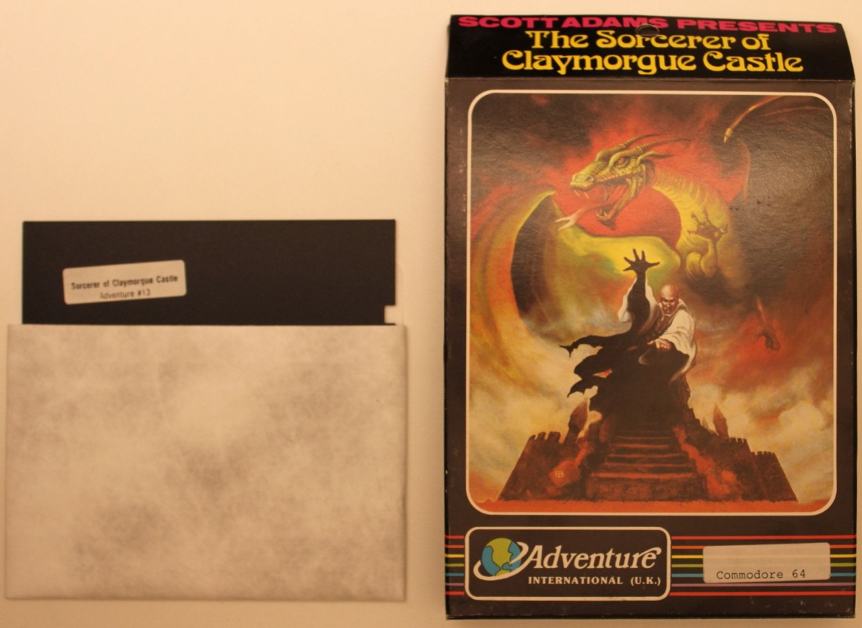
Level VI: Access Challenge
178 Scott Adams, Inc. titles in Cabrinety Collection
Mid-1980s Scott Adams, Inc. goes bankrupt
Classic games currently available as shareware on Scott Adams personal website (http://www.msadams.com/downloads.htm)
“Copyright unknown”
Not THAT Scott Adams
Notes:
One of the first companies we contacted was Scott Adams, Inc., who published games under the Adventure International label. So far we processed 178 of his titles. Since Scott Adams is an individual, he is still alive, and he has an official website where the games are provided as shareware, we thought this would be easier than contacting a large corporation.
We sent him a letter with a list of the affected game titles and requested a response on what levels of access he felt comfortable with Stanford providing. He responded almost immediately, but did not make any access choices. Instead he confirmed that the company went bankrupt in the mid-1980s and the rights reverted to the bank. Eventually the rights reverted back to Scott Adams, but in an email to us he said he did not retain the rights, and that the titles should be listed as “copyright unknown” unless we were able to track down the individual game designers who worked on each title. These titles were released in the late 70s and early 80s, and sometimes all that is listed for the game designer is a first and last name. There’s no other contact detail, which makes tracking an individual person down extremely difficult. So even though a lot of these titles are available online as shareware, we are still in a somewhat grey area with regard to what Stanford can do with the digital files.

Slide 30
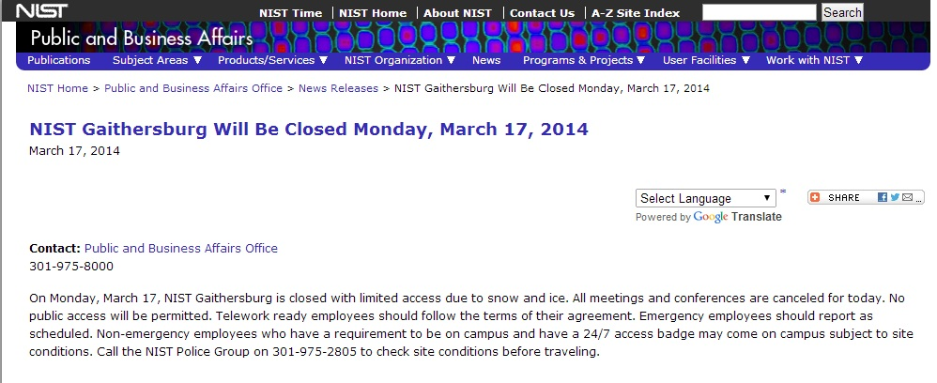
Bonus Level
Notes:
Of course, sometimes things happen that are outside of anyone’s control. The Cabrinety-NIST Project faced challenges from on-high, both in the figurative and the literal sense. The government shutdown of September 2013 meant that NIST ceased operations for the duration of the shutdown. Also, the polar vortex and extreme weather conditions affecting the northeastern coast during the early part of this year led to multiple campus closures, creating additional work stoppages at NIST.
Summarize the project goals, mention end date and ongoing challenges.

Slide 31
Thank You!
Thank You!
cthai2@stanford.edu
@cabrinety
noshrinkwrap.tumblr
How They Got Game: http://stanford.io/1kigJZJ
Notes:
Thanks for listening. If you want to read more about the Cabrinety collection or just see more pictures of it, I post images to the Cabrinety Twitter almost every day, and post images of realia to the Cabrinety Tumblr. The How They Got Game blog also includes posts about the collection, as well as other game-related Stanford news.

Slide 32
Questions?

Slide 33
Links
http://www.nist.gov/
http://gamer.ischool.uw.edu/official_release/
http://www.imls.gov/news/2013_ols_grant_announcement.aspx#CA
http://www.entmerch.org/
http://id.loc.gov/authorities/subjects.html
http://www.mobygames.com/
http://www.msadams.com/
https://www.atariage.com/
http://coolrom.com/
http://www.retrode.org/
http://www.stanford.edu/group/htgg/cgi-bin/drupal/?q=node/1179
http://www.fiercegovernmentit.com/story/nist-commerce-department-mostly-close-under-government-shutdown/2013-09-30
http://bit.ly/1hL3OPS
http://arstechnica.com/gaming/2013/01/todays-atari-bankruptcy-latest-in-a-long-history-of-corporate-deaths/
http://us.blizzard.com/en-us/

