Slide 1
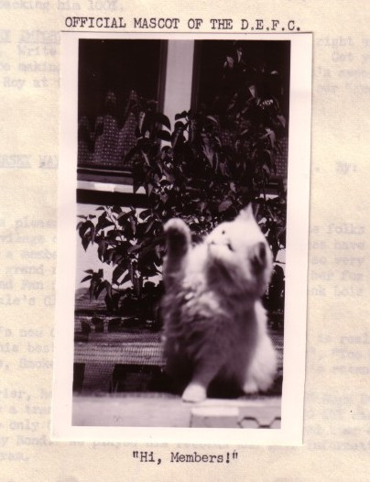
The Access Tightrope: Balancing Privacy and Access
Notes:
-relatable title (tension in what we do)
-needs for balance in archives
Budget and preservation
Time and processing needs
AND access and privacy!
Need to be thoughtful to keep balance and continue walking forward across whichever tightrope we’re traversing
--------------------------------------------------------------------------------------------------------------------------------------
We’re going to look at how archivists find their balance at two institutions
<speaker intros: get from Michael, intro Charlie, intro self>
1. risk management issue
2. ethically gray area
3. SAA core values describe access: “Archivists promote and provide the widest possible accessibility of materials, consistent with any mandatory access restrictions, such as public statute, donor contracts, business/institutional privacy or personal privacy.”
4. third party privacy (those unaware their words or images were donated to an archive)
5. increased concerns with digital access to archival materials and ease in disseminating information

Slide 2
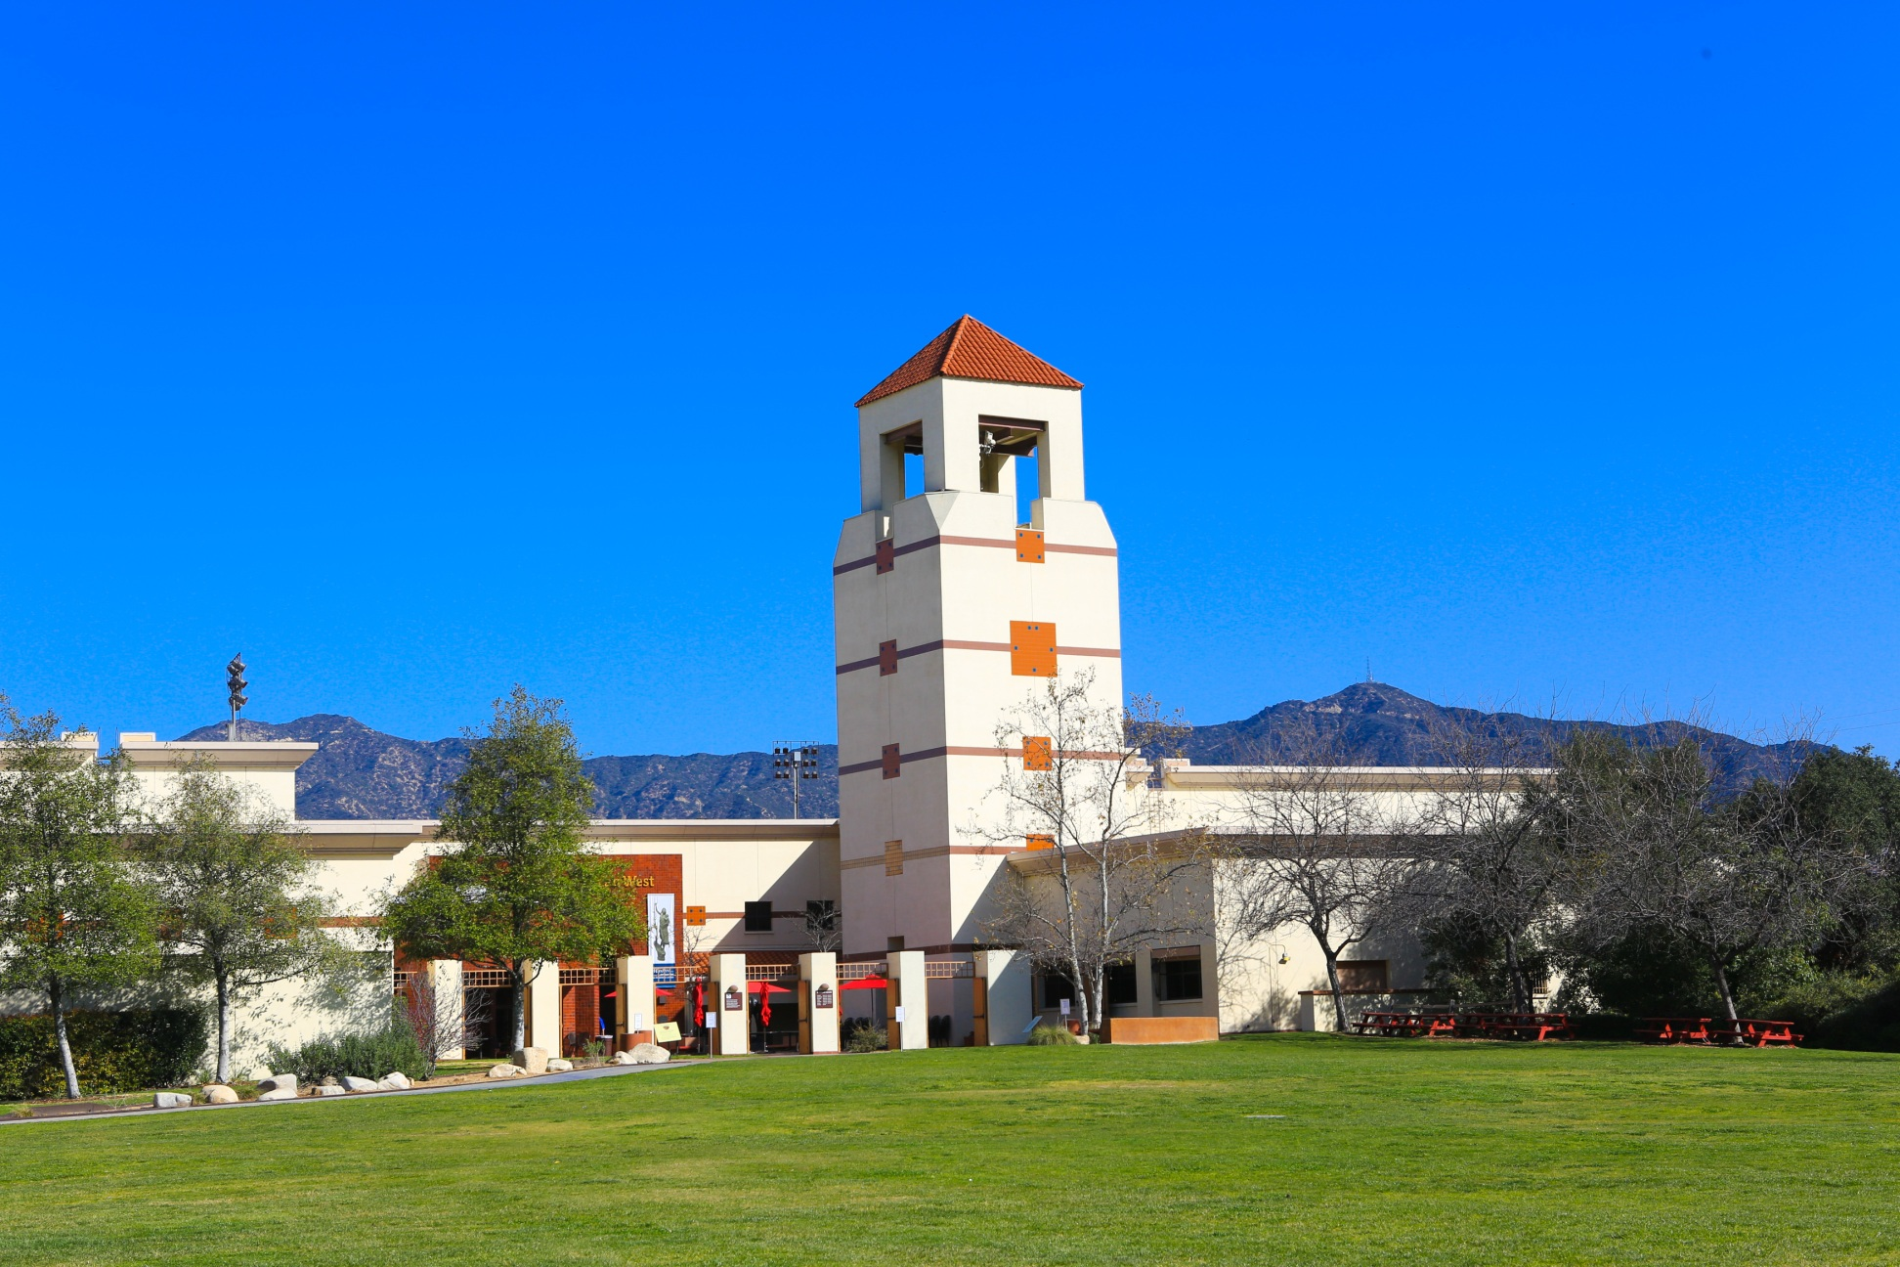
Libraries and Archives of the Autry
Notes:
-both archives housed here, one of two libraries at the Autry National Center, a museum in Los Angeles “dedicated to exploring and sharing the stories, experiences, and perceptions of the diverse peoples of the American West”
-The museum recently celebrated it’s 25th anniversary, but the Autry Research Library first opened to researchers in 1995 (one of two libraries at the Autry)
library collection strengths: history of trans-Mississippi West; material culture of ranching and cowboy; business of western entertainment (literature, live performance such as Wild West shows, rodeo, theater, and music, film, television); tourism; product advertising; fine art;

Slide 3
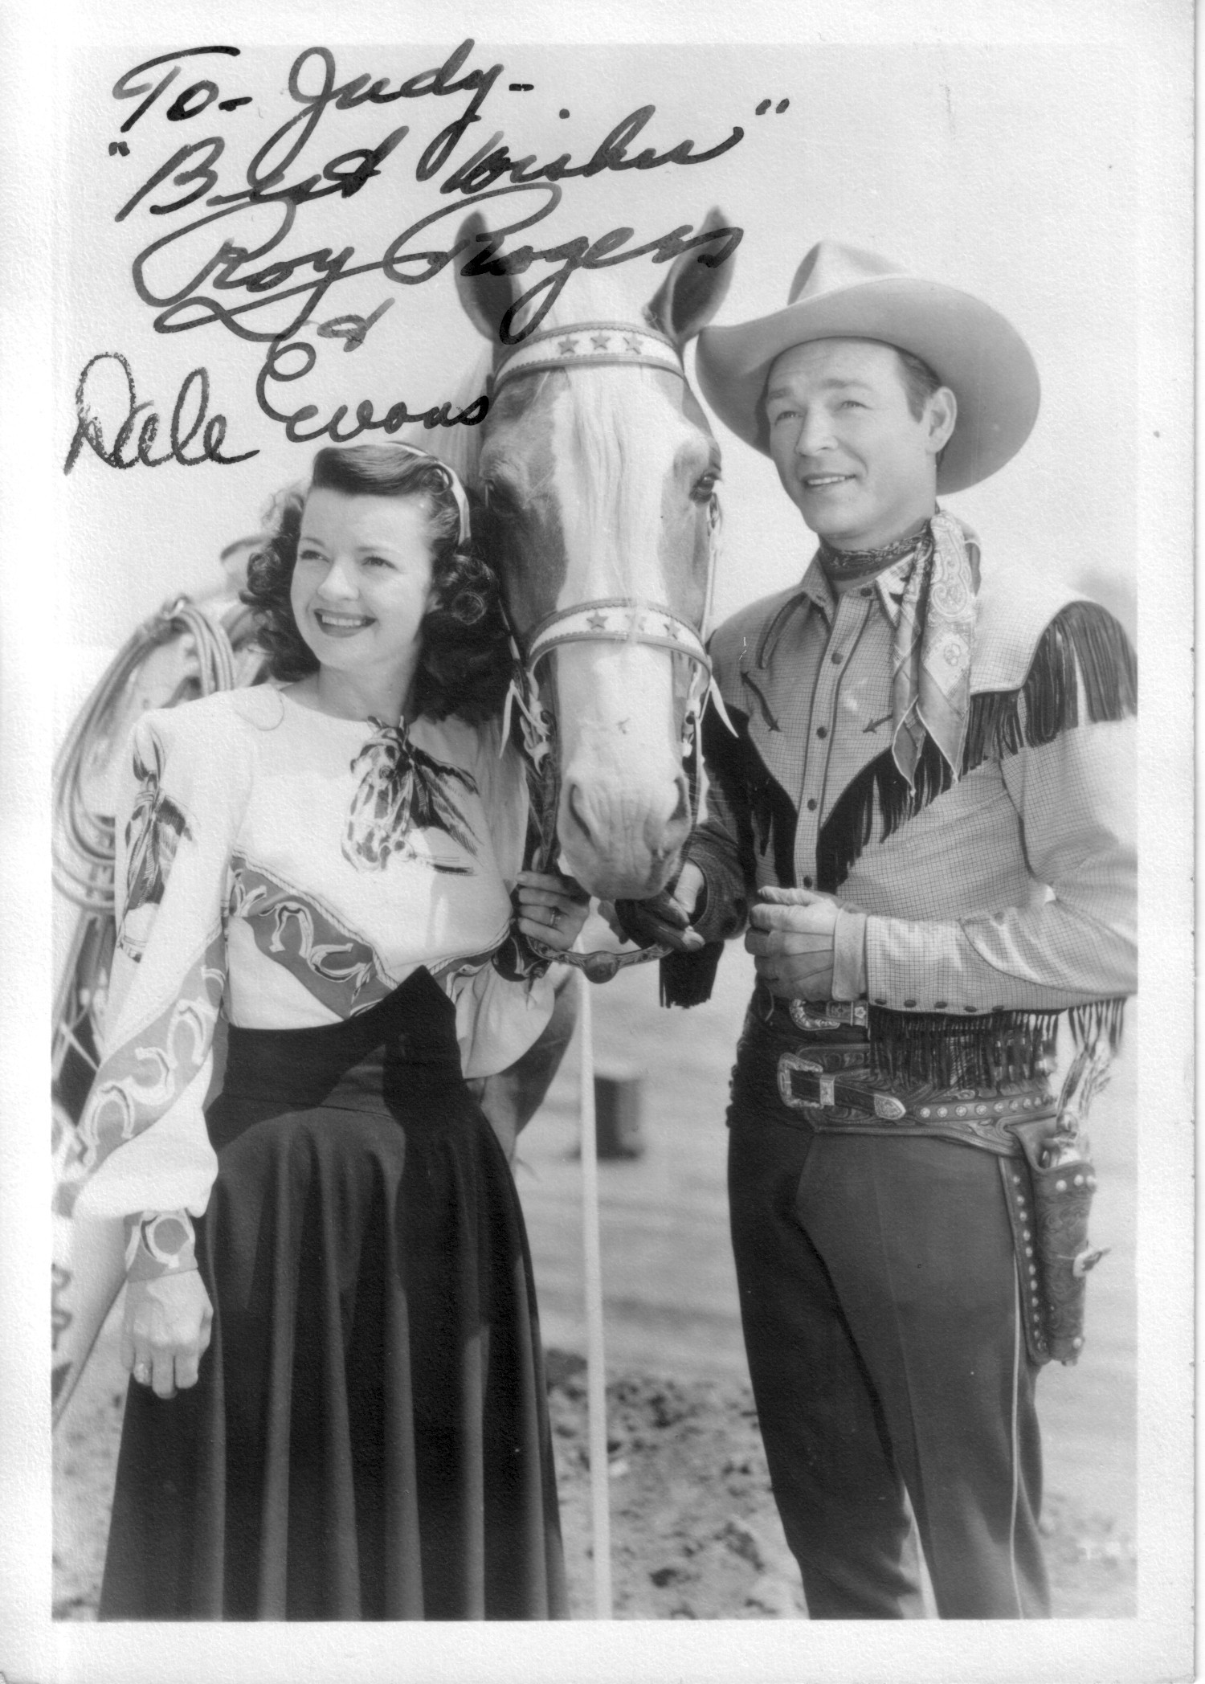
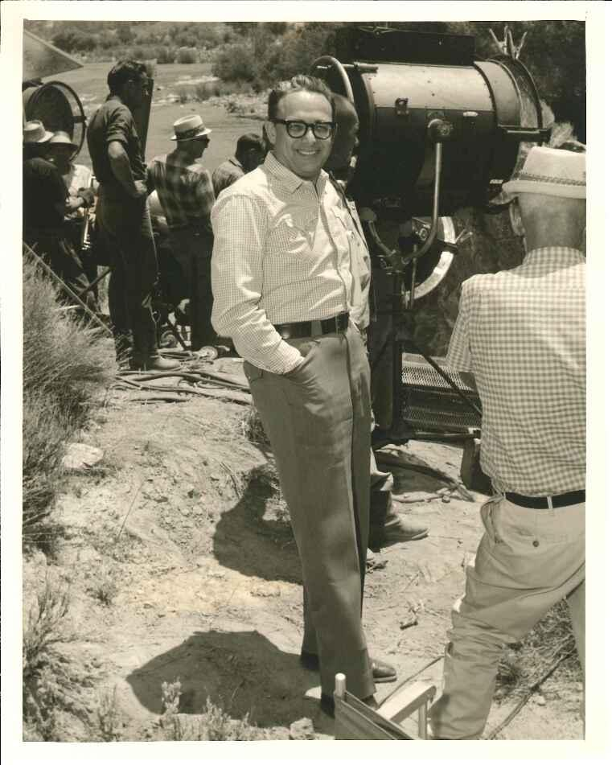
Notes:
-2 archives the business of Western entertainment
-20th century archival materials
-privacy issues related to the fan materials in these Archives

Slide 4
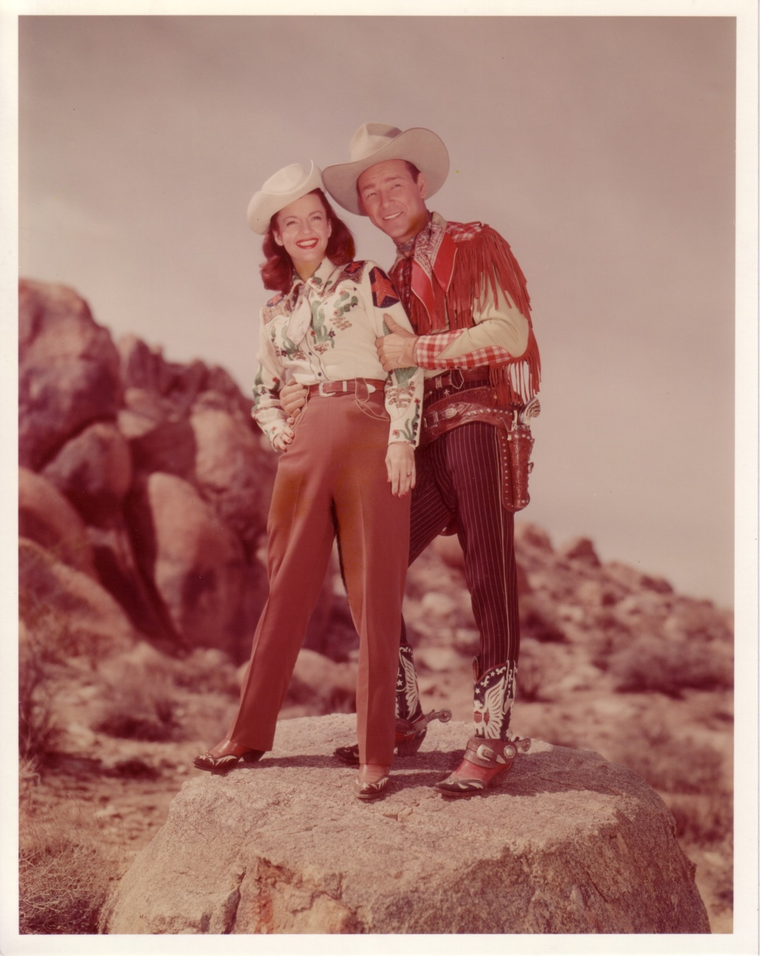
Roy Rogers and Dale Evans Archives
Notes:
125 linear feet
contains publications, press clippings, photographs, slides, promotional materials, correspondence, sheet music, ephemera, and business records relating to the film, television, and recording careers of Rogers and Evans, primarily from the 1940s until 2000, fan materials primarily 1940s-1950s, some later materials, mostly correspondence
-primarily a business archive reflecting brand marketing strategies and offering insight into fan reception
-Roy Rogers and Dale Evans: radio, film and television stars.

Slide 5
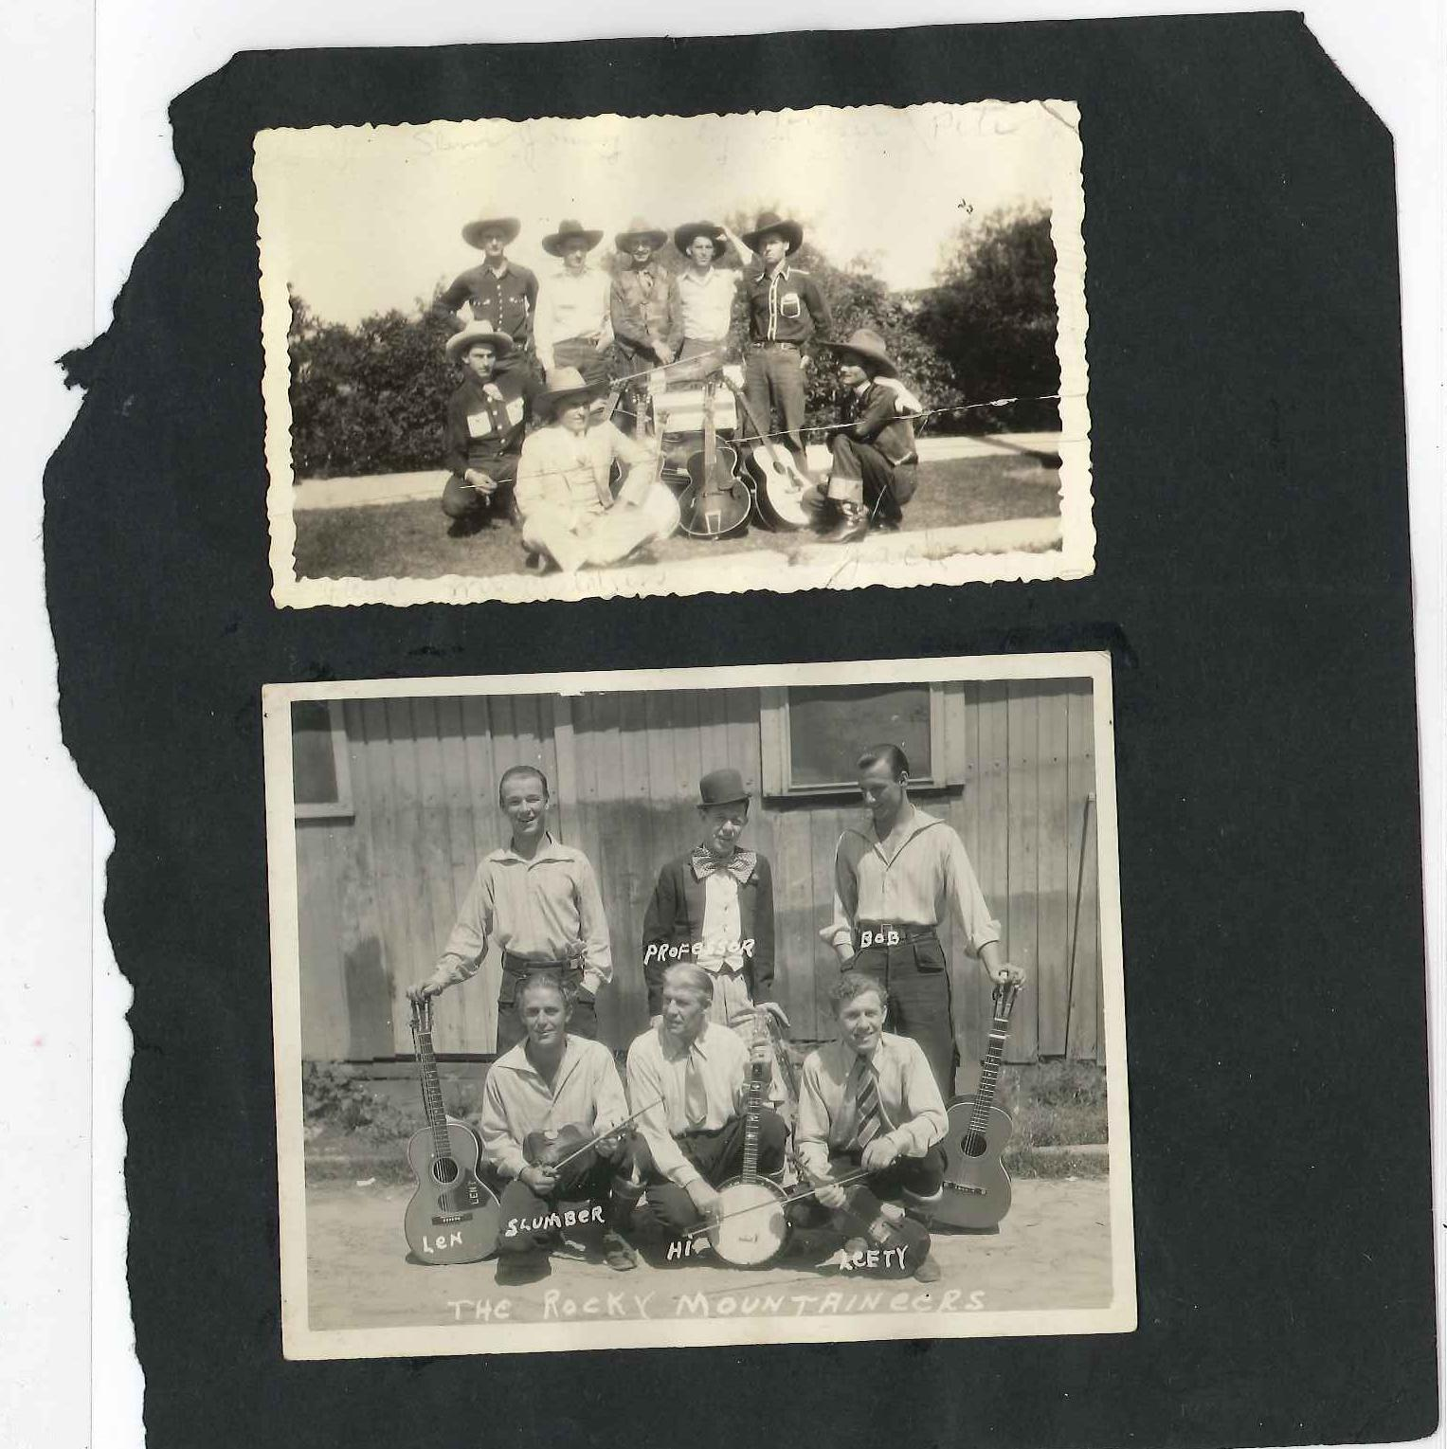
Notes:
-Roy Rogers: Cowboy from Ohio – Sons of the Pioneers, Republic Pictures star, radio, television series in 1950s, 1960s
-first starring role in a Republic picture in 1938
-lower picture is Rogers in the Rocky Mountaineers

Slide 6
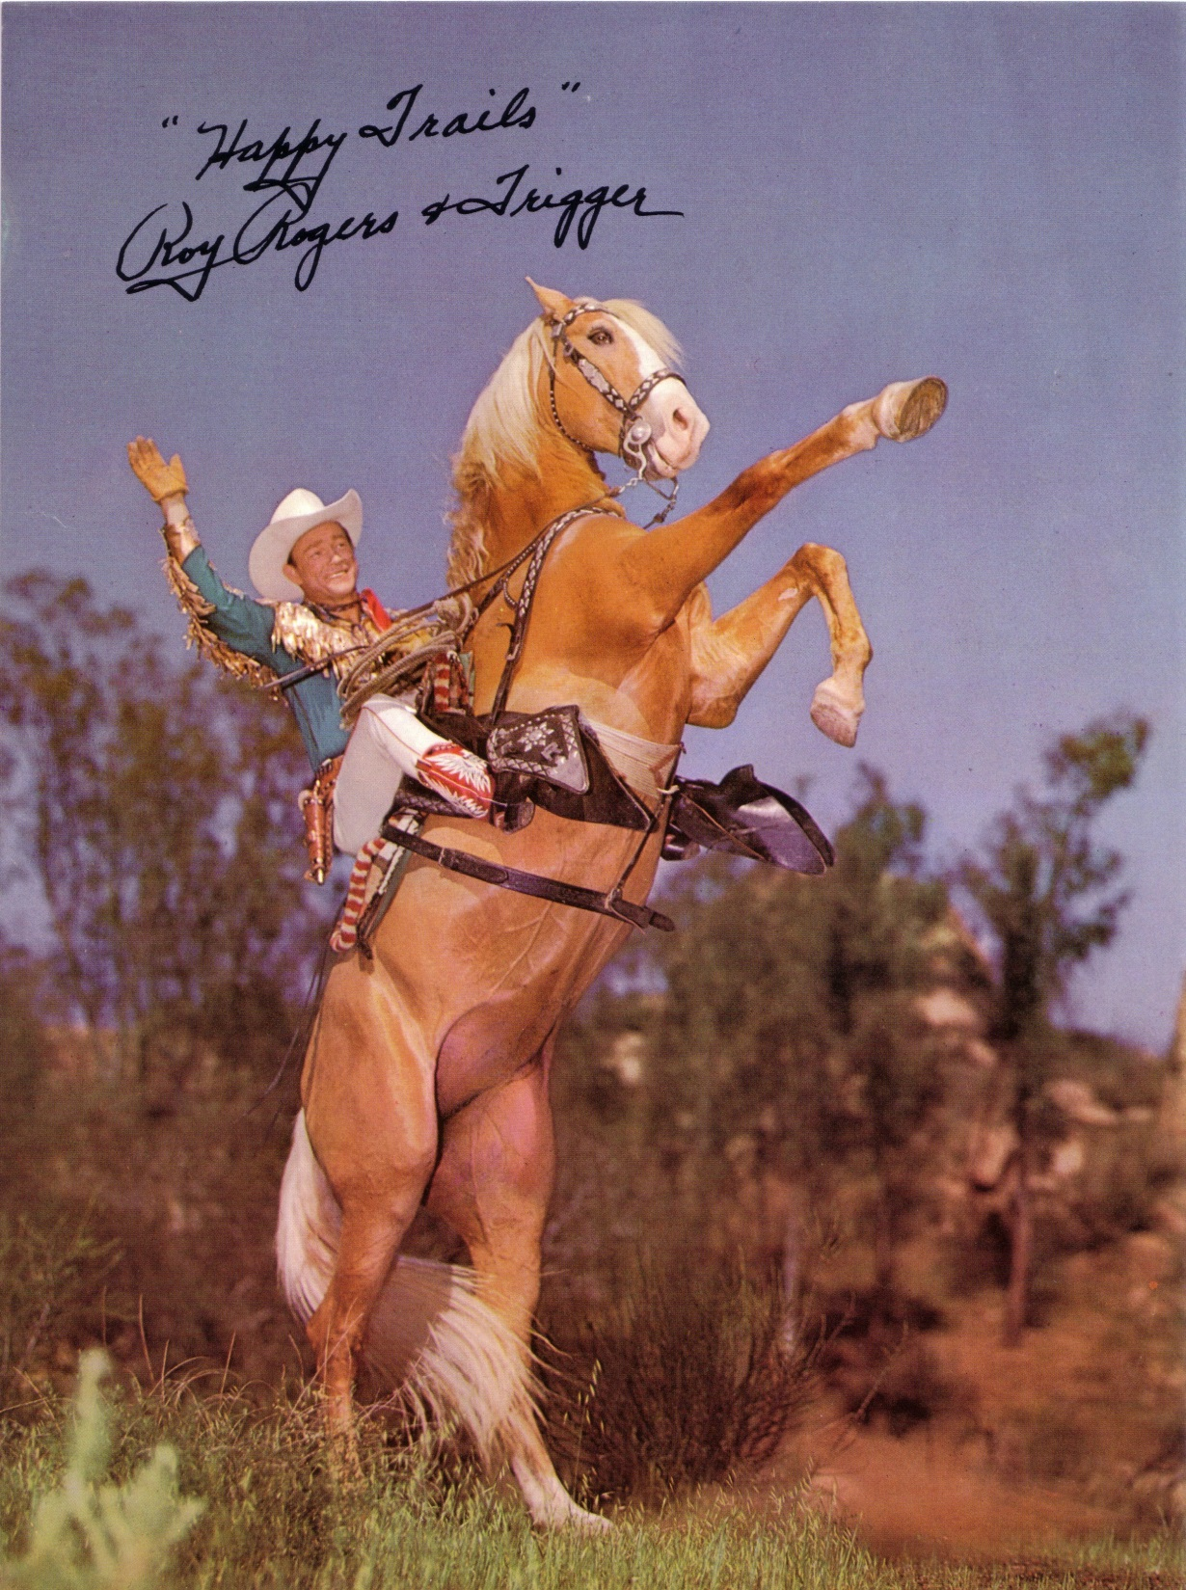
Notes:
-born Len Slye, but really became Roy Rogers (legally changed name, lived his character)
- made Republic films until the early 1950s, switched to television in the 1950s and into the 1960s and in later years did a lot of public appearance tours

Slide 7
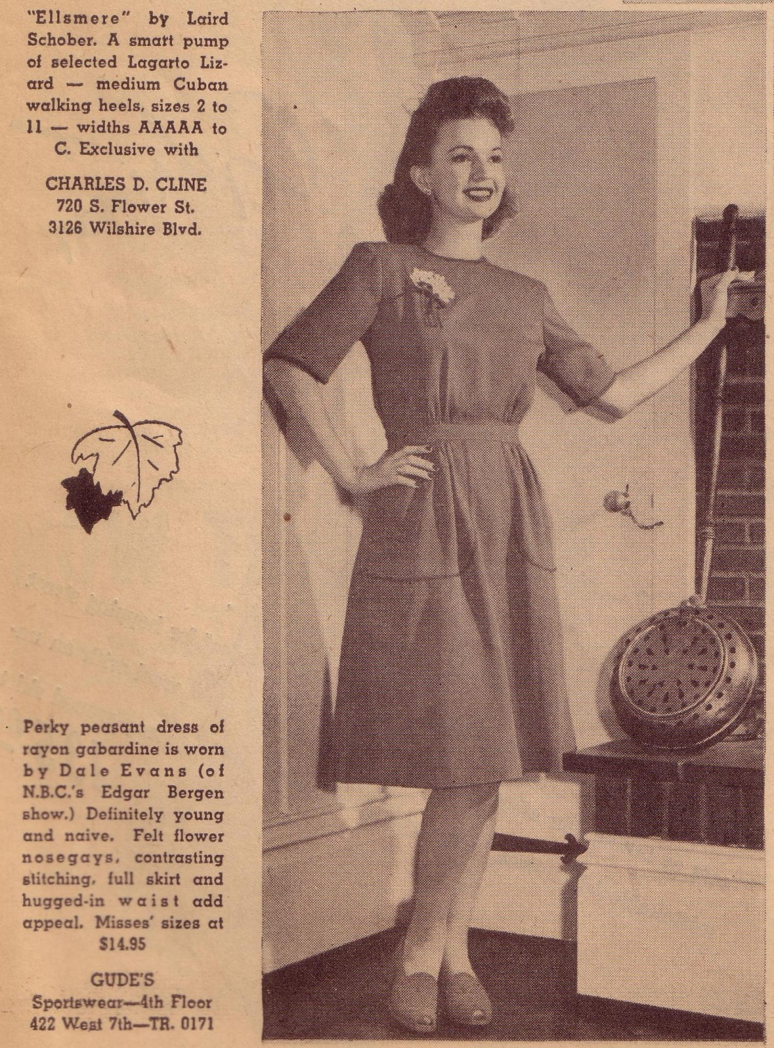
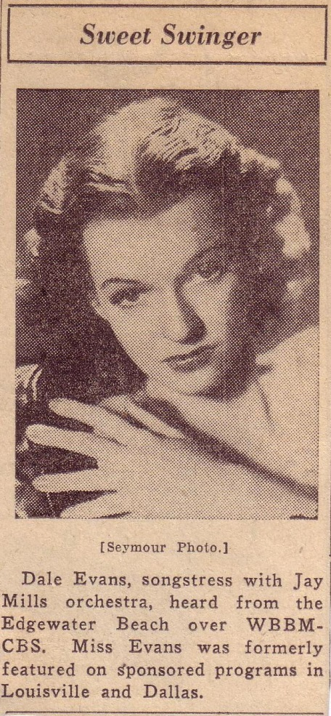
Notes:
Radio, singer, songwriter, author
-movies in the 1940s, married Rogers in 1947 while they were costarring in Republic Pictures Westerns

Slide 8
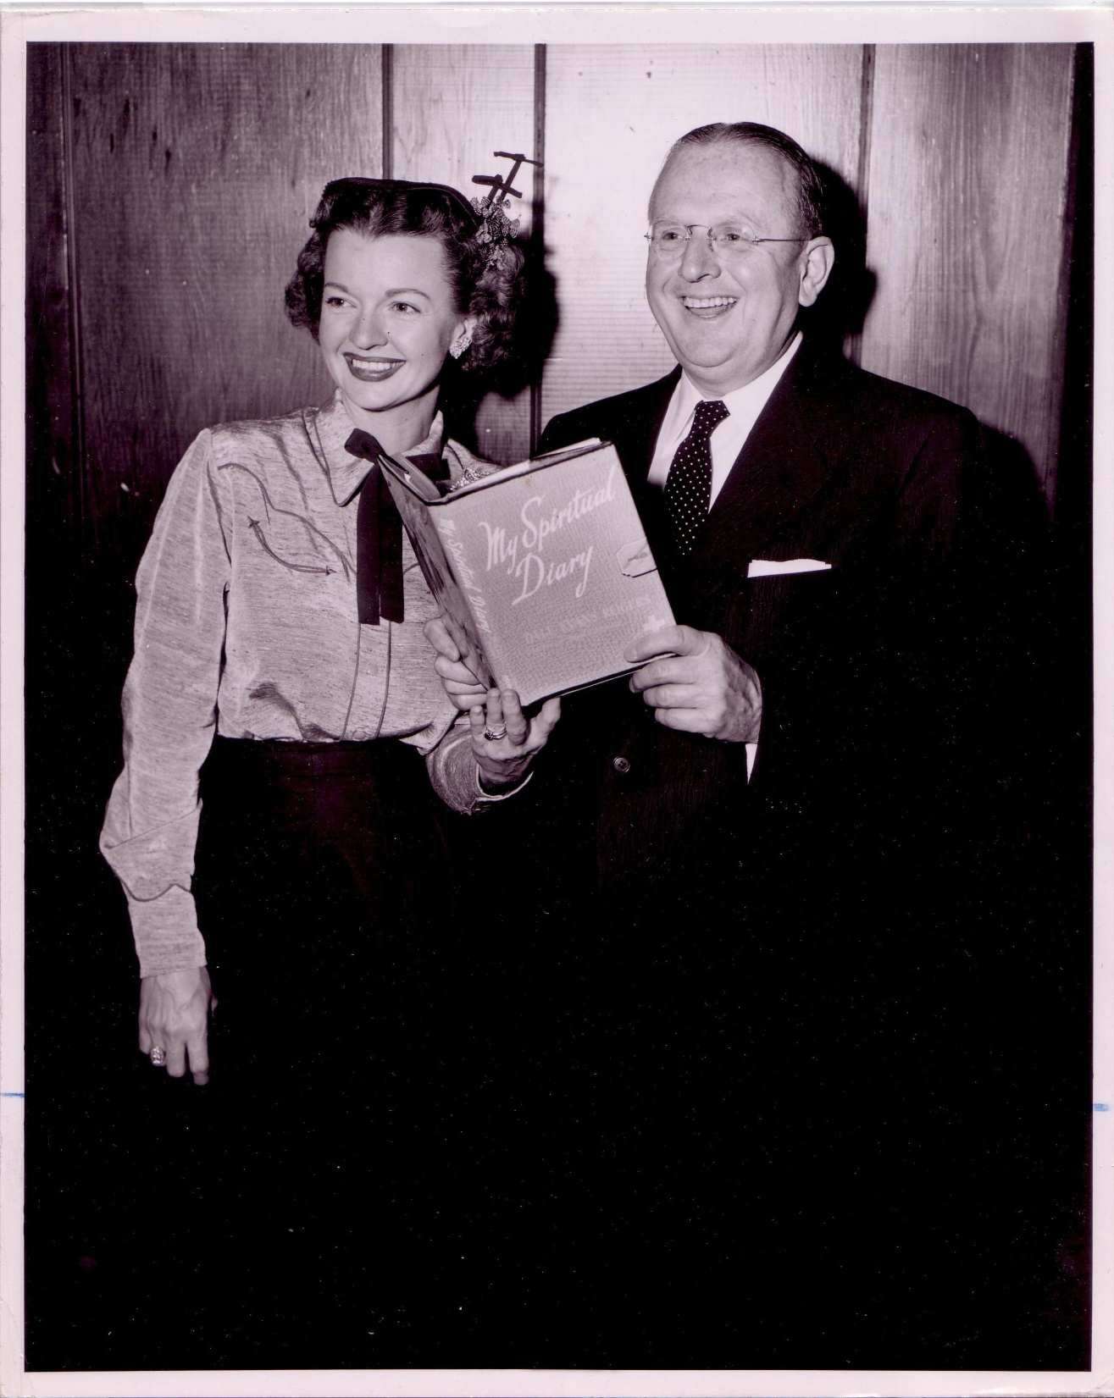
Notes:
Later (independently of Rogers): religious inspirational books based largely on her life experiences

Slide 9
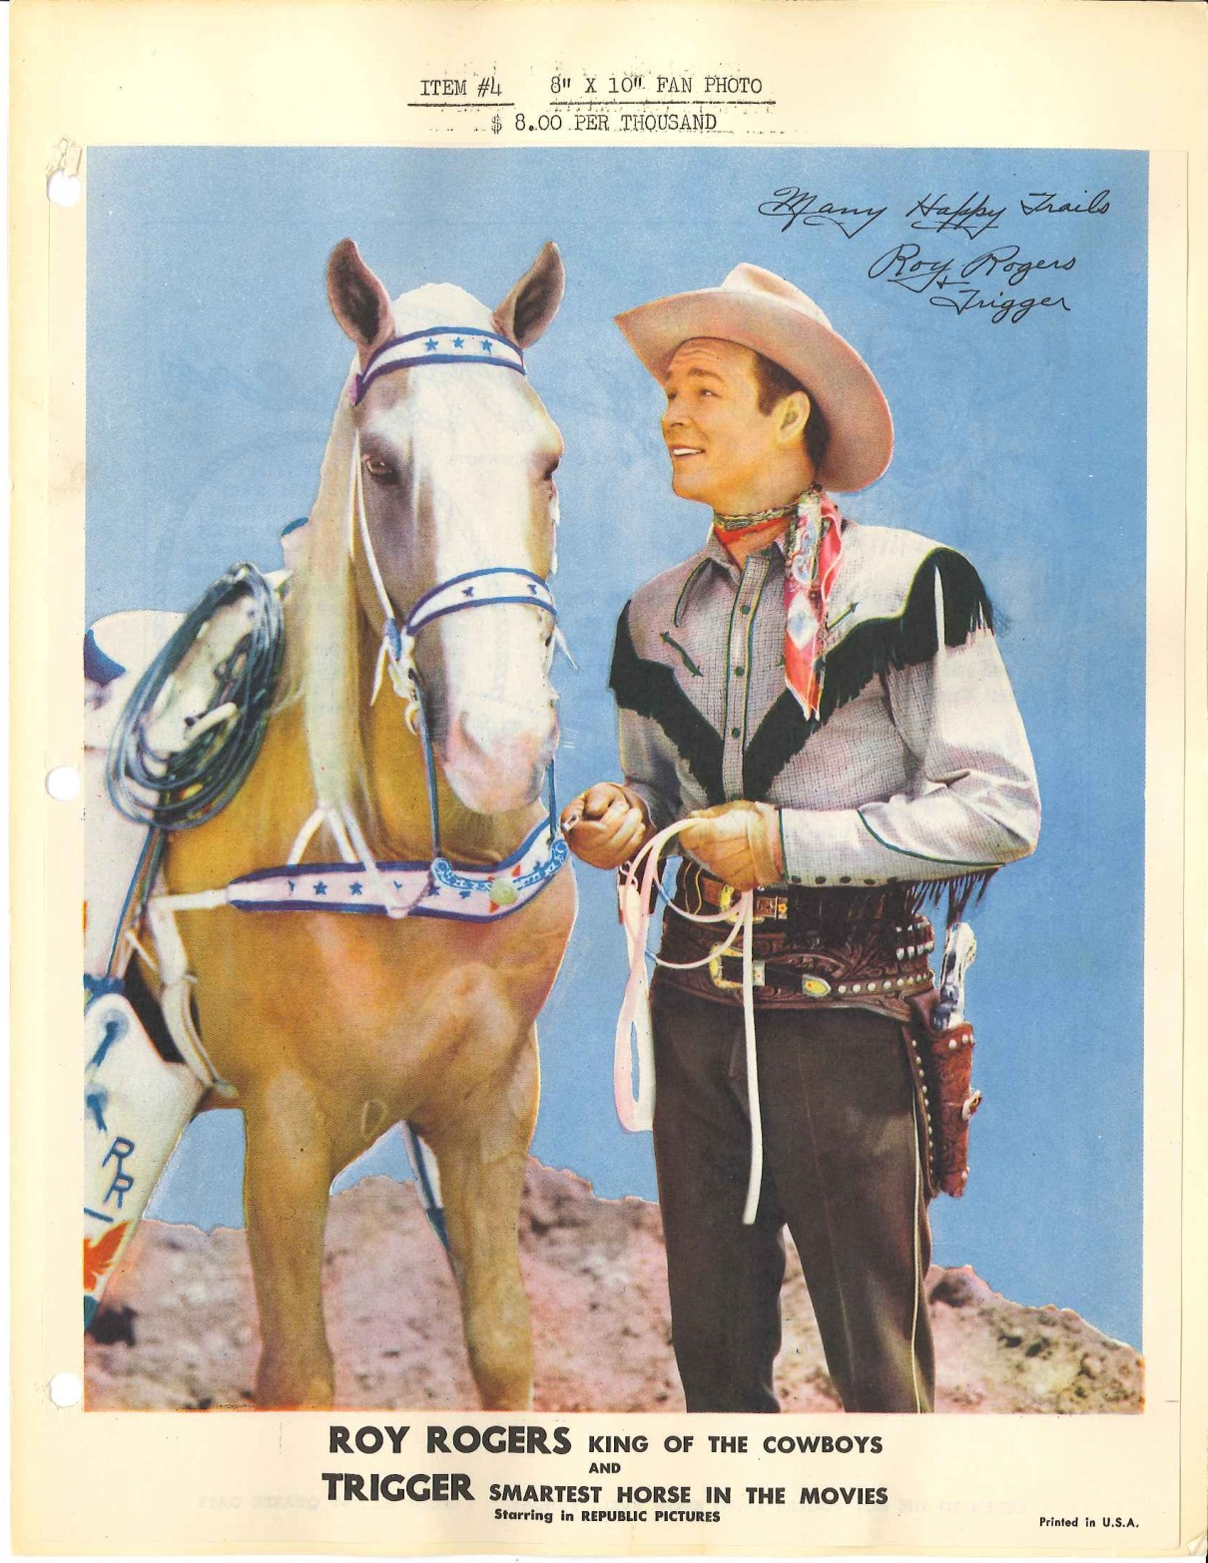
Notes:
-big on branding/marketing their image
-Roy Rogers with his horse Trigger

Slide 10
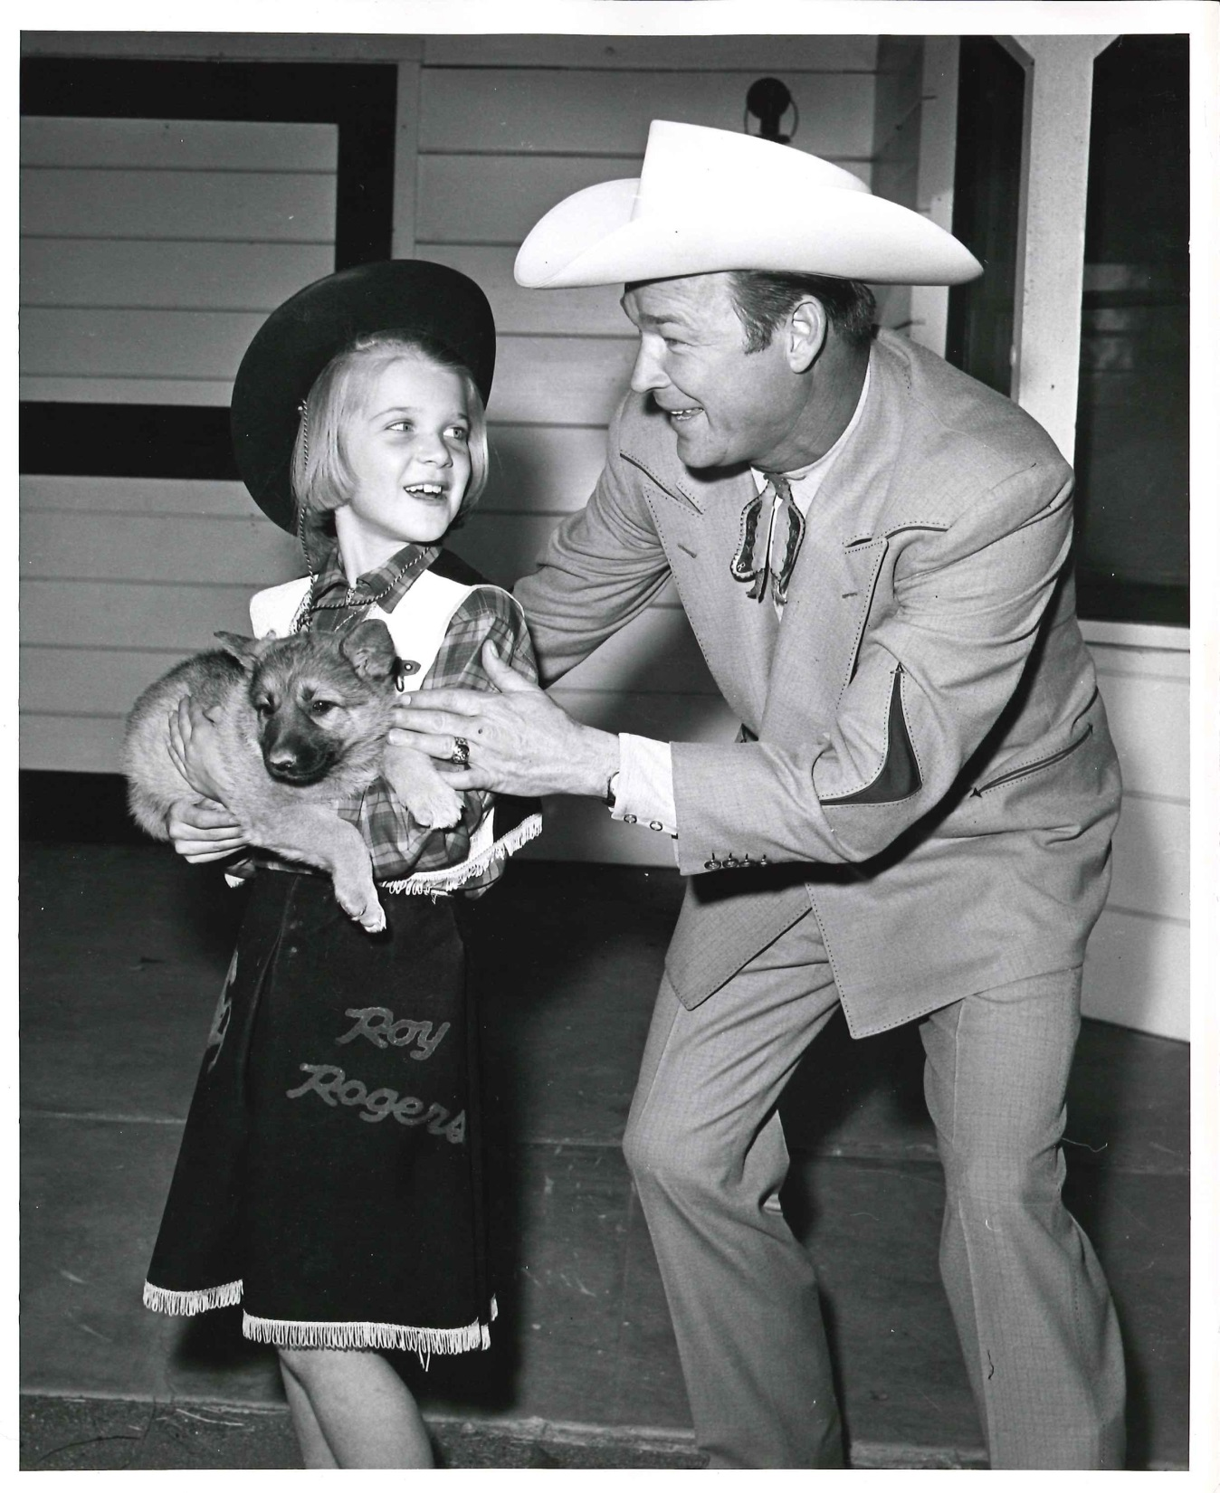
Notes:
Marketed all sorts of items, including clothing (here a photo from a puppy contest)

Slide 11
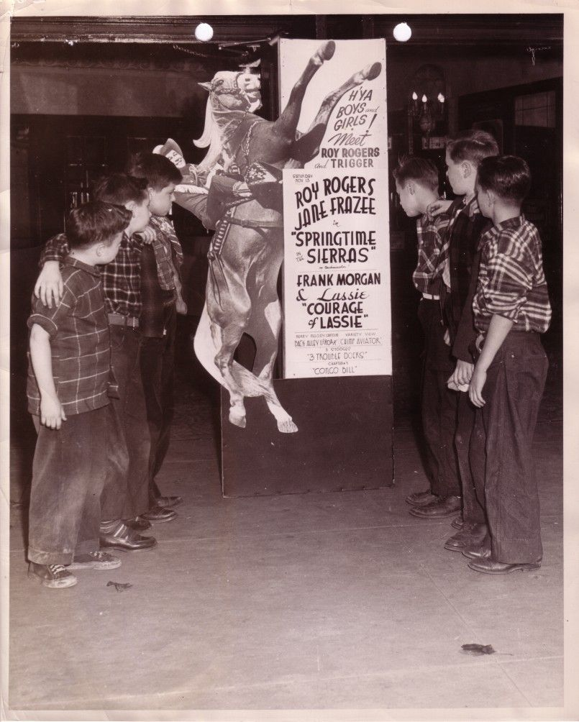
Notes:
Audience primarily children

Slide 12
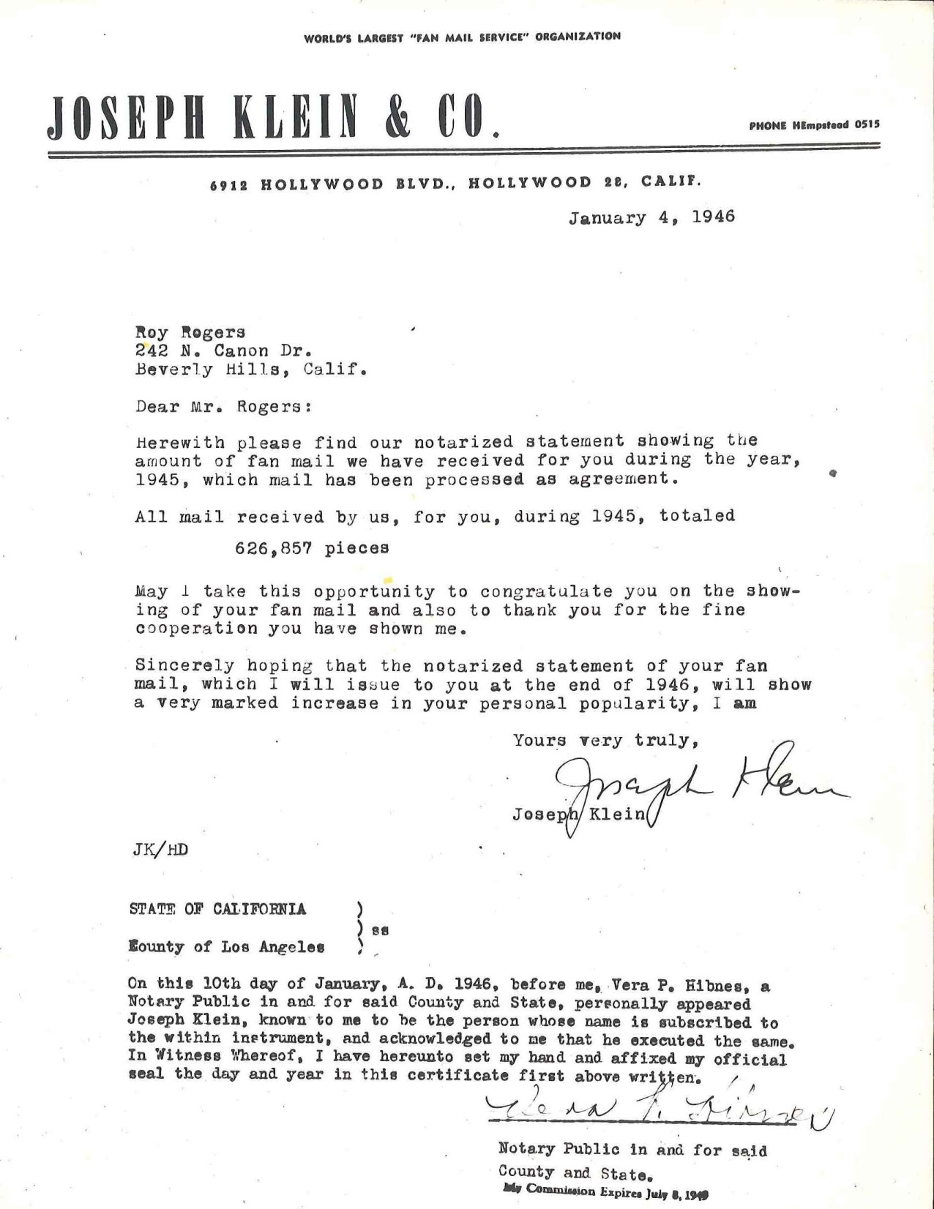
Notes:
-high volume of fan response
-active fan engagement with Rogers and Evans

Slide 13
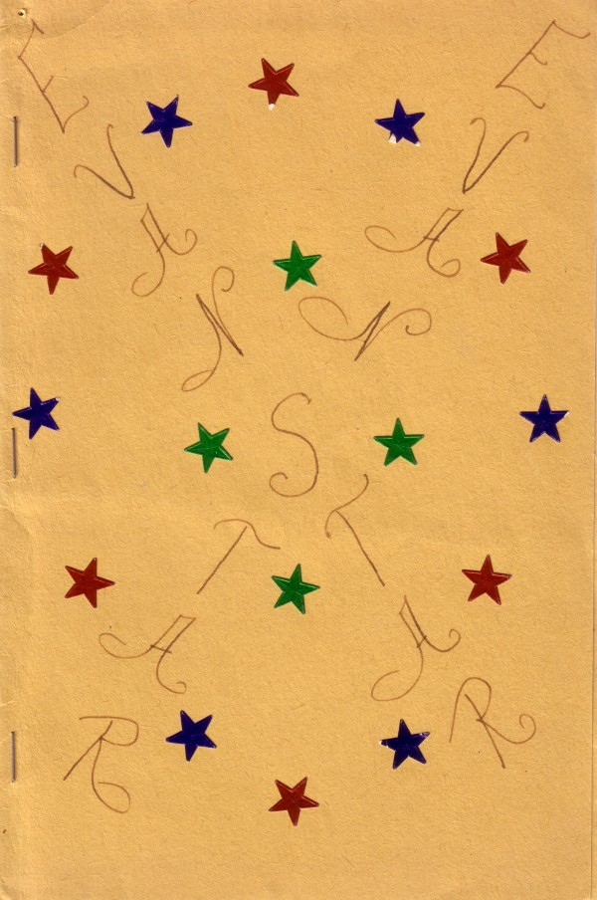
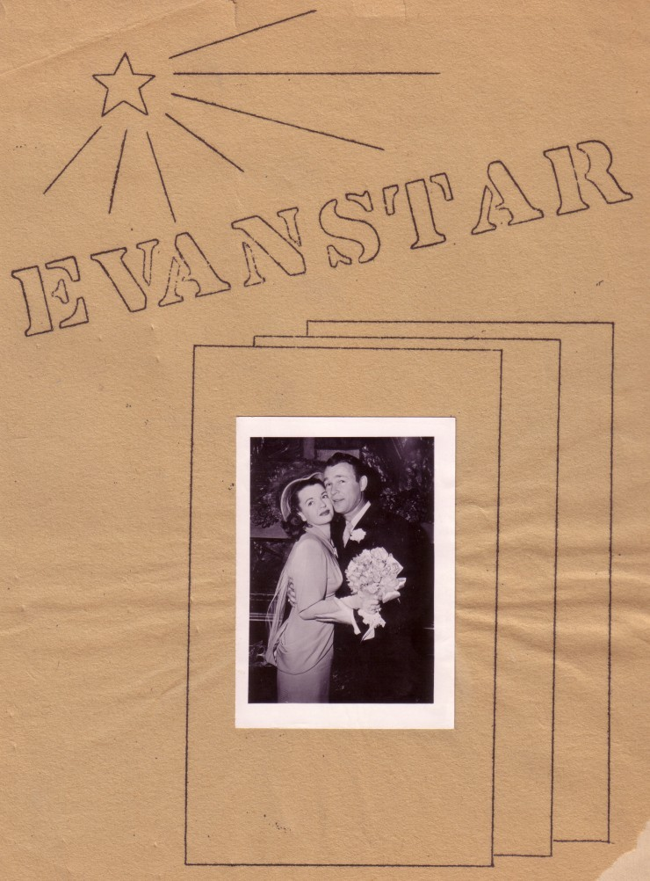
Sample title
Notes:
Materials generated by fans in the 1940s and 1950s
Before internet 2.0 fandom – 2 fanzines

Slide 14
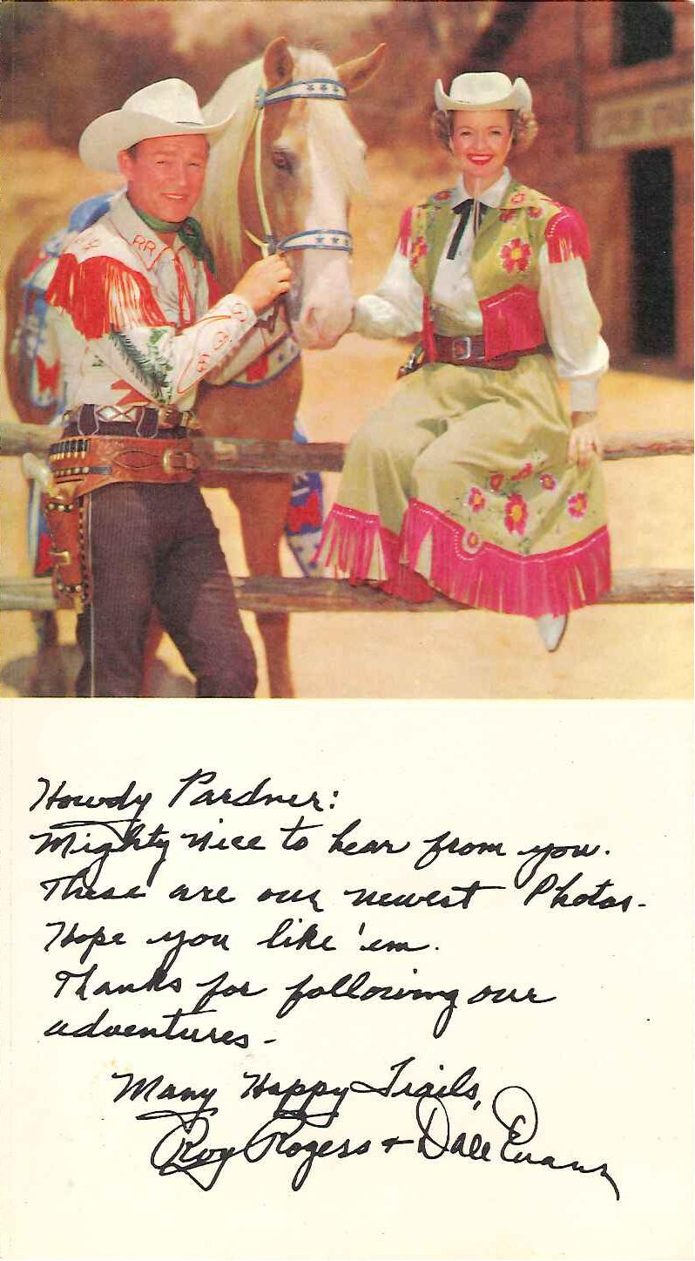
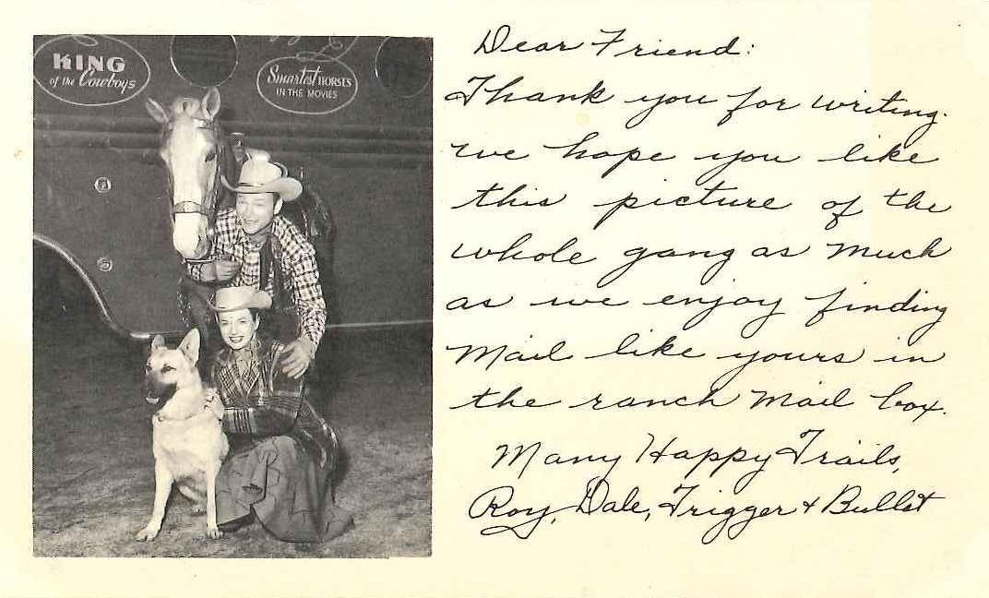
Notes:
As a result their fans felt like they could talk to Roy and Dale as pals/“friends” (letters refer to them as “friends”) young fans connected with the stars through their warm friendly language

Slide 15
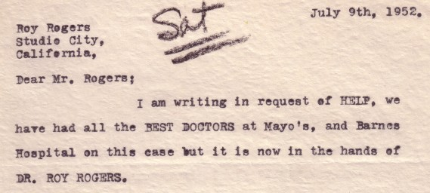
Notes:
He was not only a friend, but also a hero. When kids became sick and were hospitalized for polio, cancer, they wrote to Rogers (feeling of intimate rapport)
His acknowledgment in the form of a letter, autographed photo, phone call, or visit was seen as a tonic that no form of medical treatment could provide

Slide 16
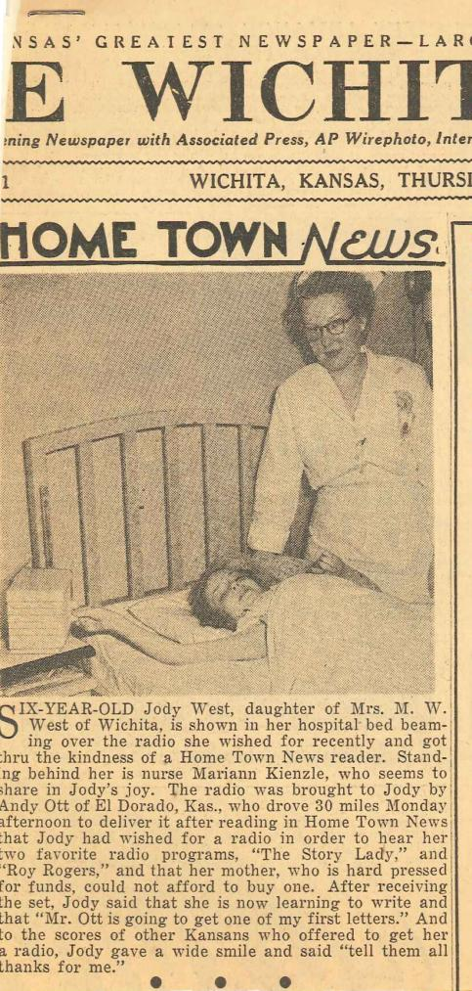
Notes:
-illness and childhood in mid-20th century America
-privacy issues: what made me stop while processing
Personal names and addresses
-Mention illnesses
-rarely, but occasionally include photographs of the child correspondent or the child subject of the letter

Slide 17
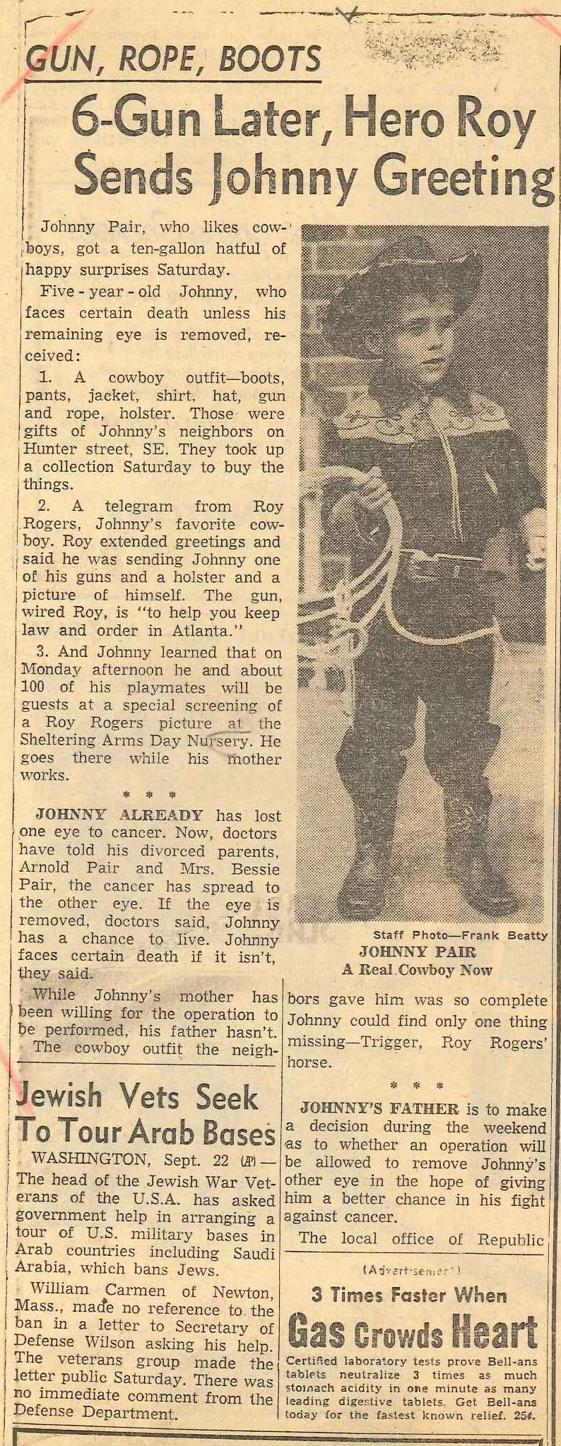
Notes:
-considered imposing a term of restriction (maybe 72 years like the census? Dates can be arbitrary)
-considered censoring names/addresses on correspondence on an “on demand“ basis as researchers request the material

Slide 18
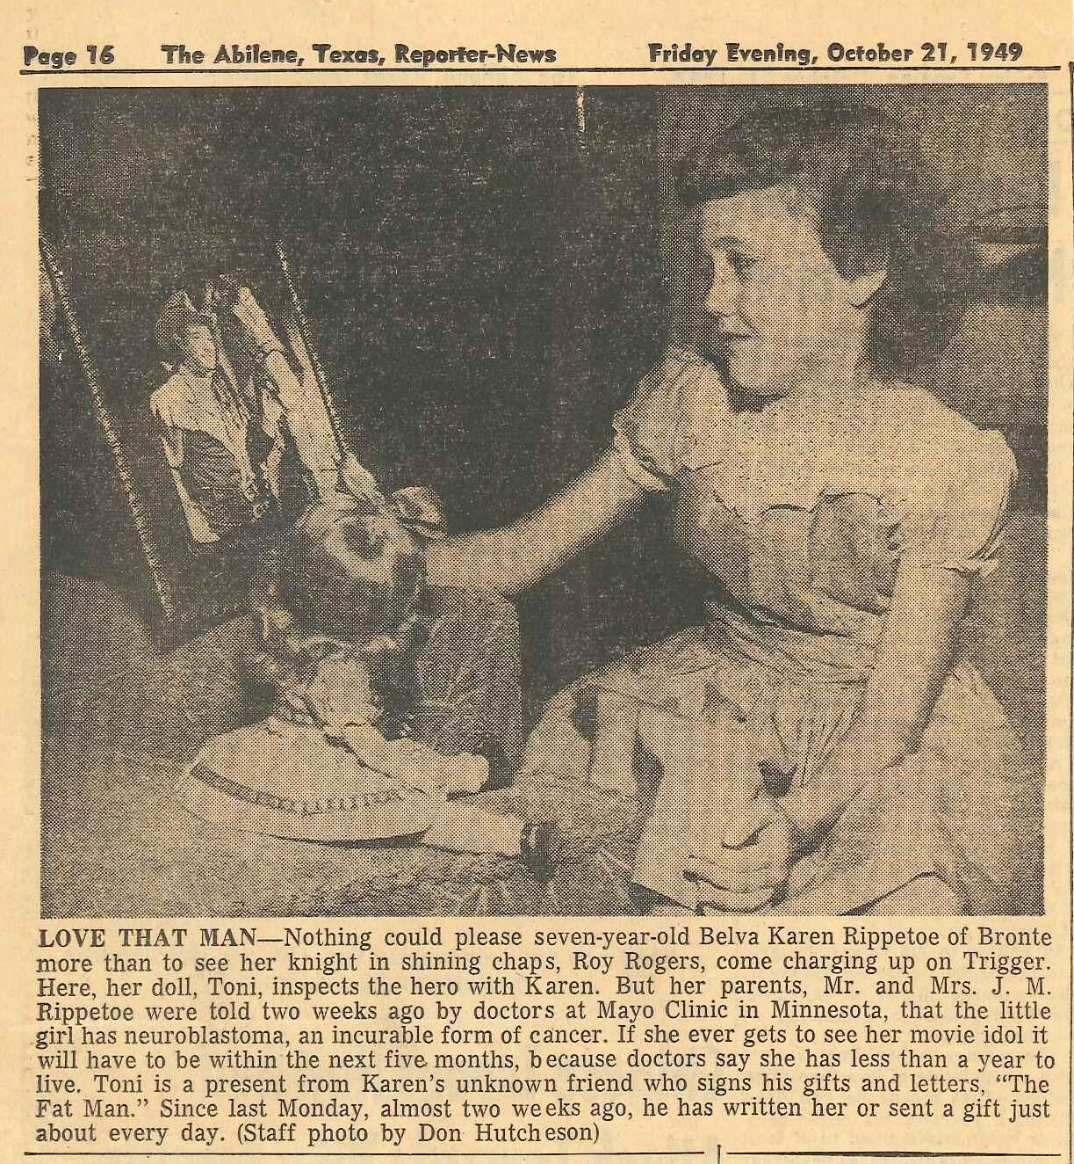
Notes:
-counter to the privacy issues:
-often used hospital address, not home addresses
-often accompanied by newspaper articles detailing medical conditions, sometimes with contact info
-letters don’t go into detail on the illnesses and treatment plans (except “only going to live another two months”)
-age: letters almost all written between 1948-1950

Slide 19
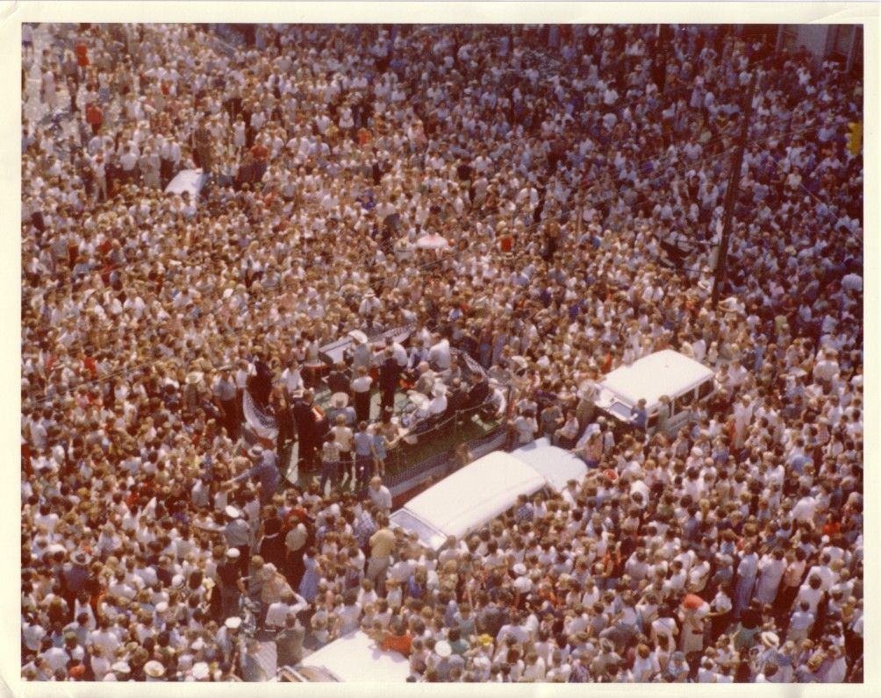
Notes:
-Box level finding aid on OAC
-there is a folder listing of material available by researcher request, but even this listing does not include specific names of individuals listed in the “sick children” files (or interesting letters file – not all the kids were sick!)
-someone wouldn’t Google a name and come across information on particular individual’s childhood illnesses

Slide 20
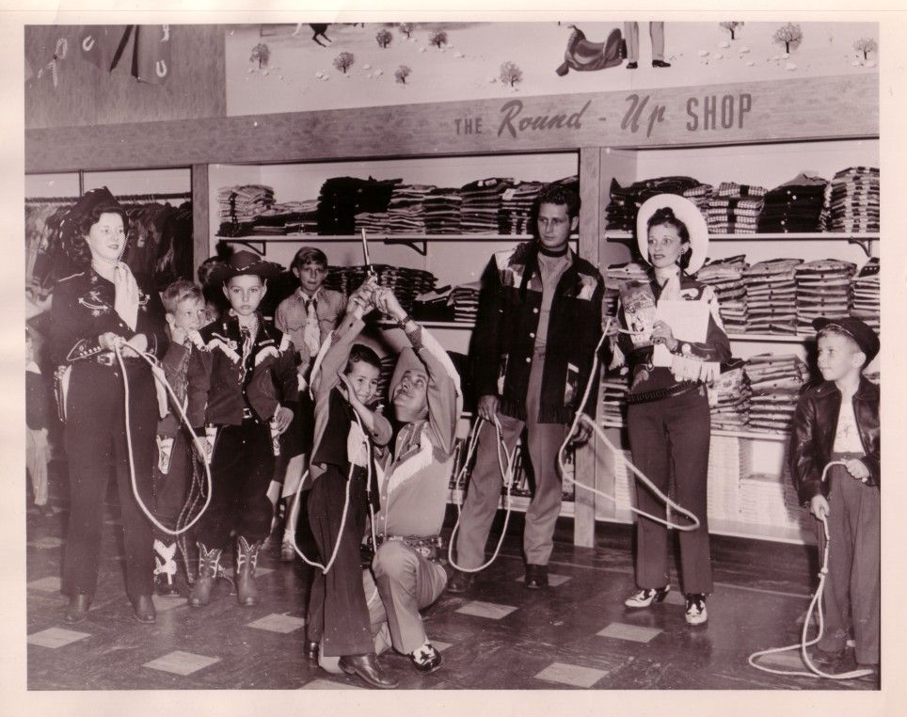
Notes:
-risk is very low, awareness of Archives’ contents is important, but low risk due to:
-age of materials
-news clippings that demonstrate public knowledge of childhood illnesses
-searchability of correspondent names not possible, so random discovery and disclosure of any individual’s information will not happen online (only in person researchers, and we will have a record of who used the Rogers and Evans Archives)
DATE OF PHOTOGRAPH
-date restrictions are arbitrary (NOTE BUT DON’T STATE: and does placing a restriction note on these folders lead to an acknowledgement and potential additional liability burden placed on the respository?)
-date restrictions worthwhile to satisfy the desires of a donor, within reason

Slide 21
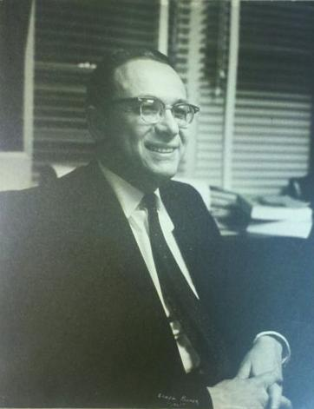
David Dortort Archives
Notes:
110 linear feet
The David Dortort Archives contains materials documenting the film and television work of David Dortort, best known as creator of Bonanza. The bulk of the Archives relates to Dortort's television work in the 1960s and 1970s.

Slide 22
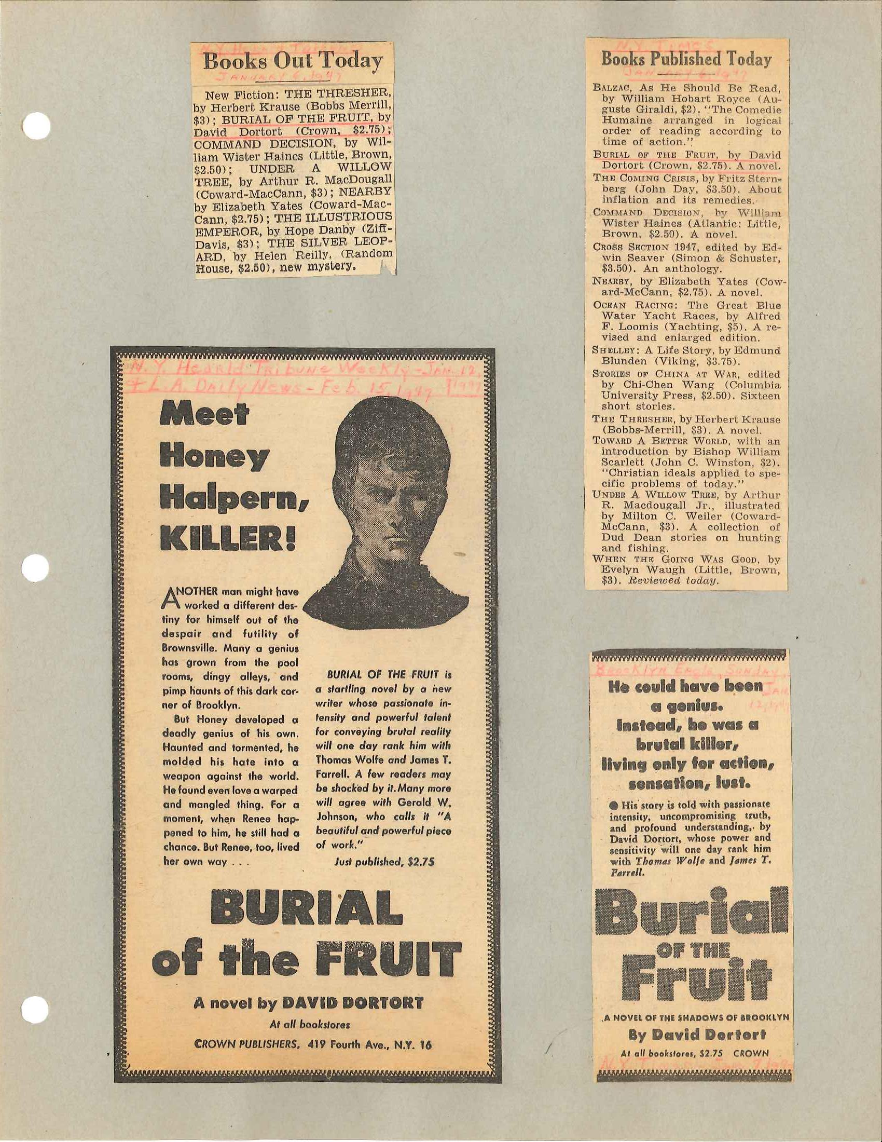

Slide 23
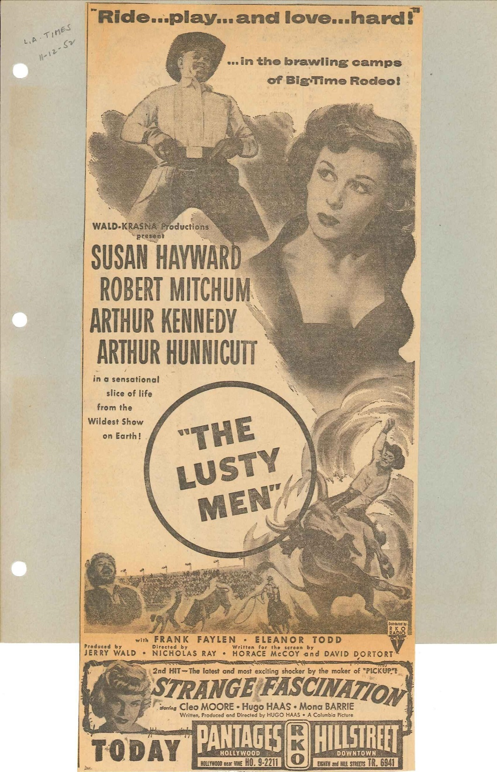

Slide 24
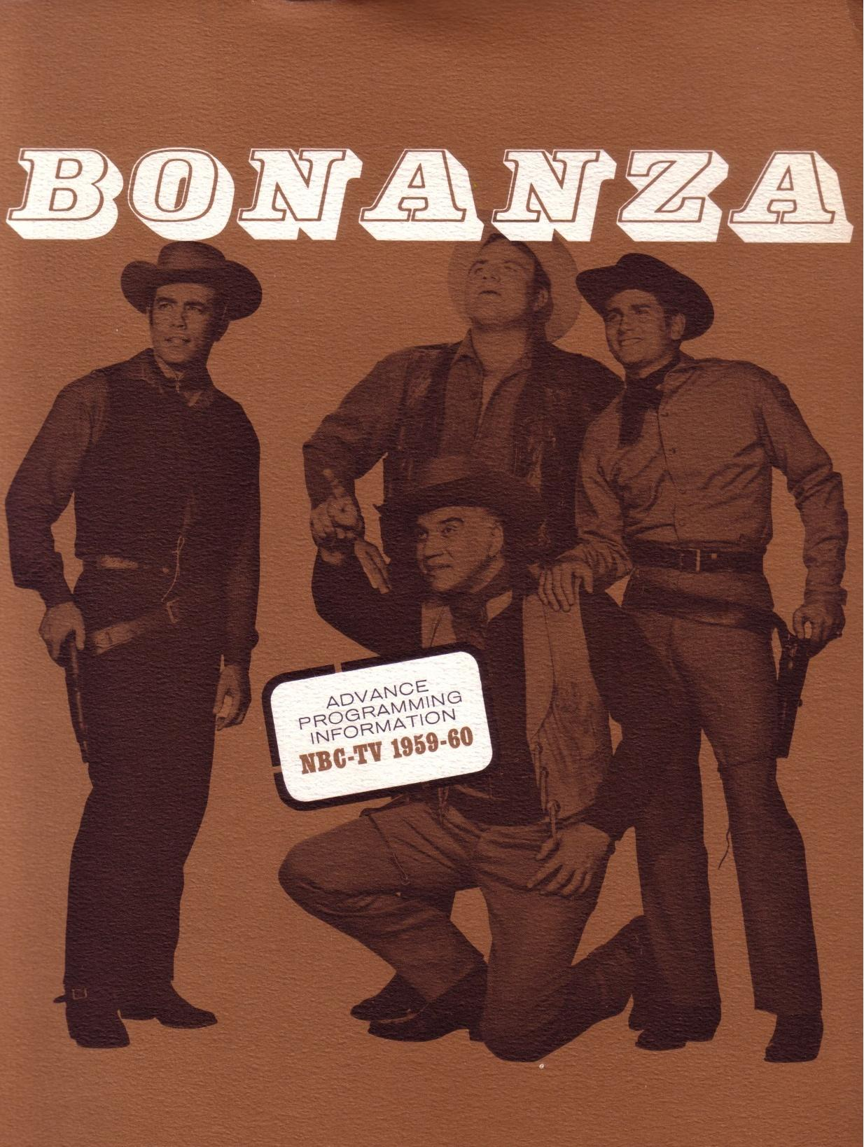
Notes:
The Restless Gun
-hour long color television program, NBC execs unsure he put some of his money on the line
1959-1973

Slide 25
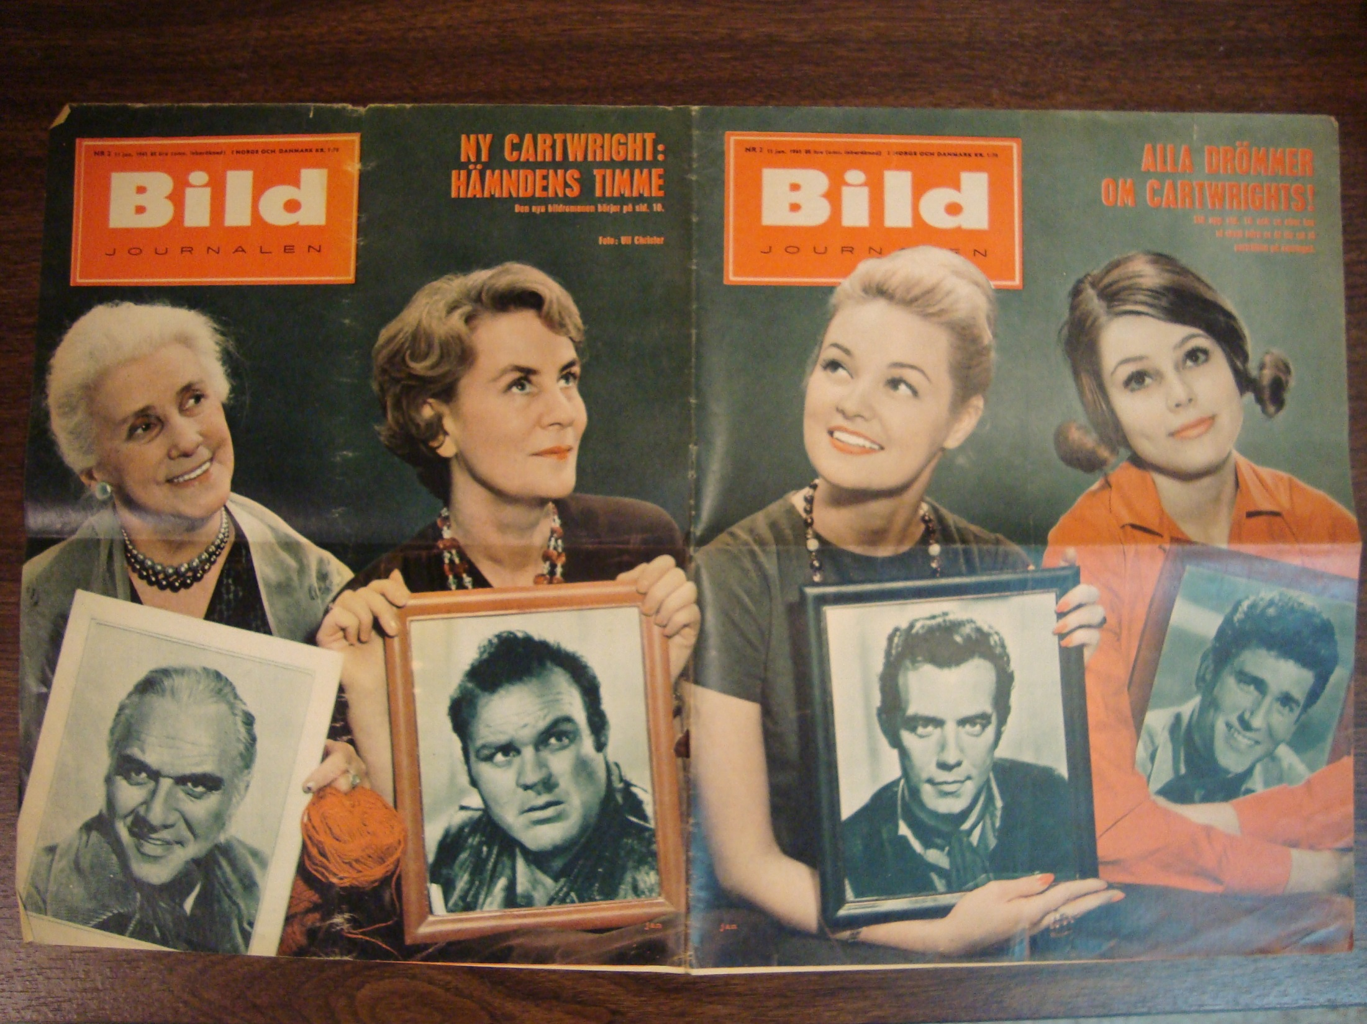
Notes:
-legally private versus ethically private (fans reveal personal/initmate/emotional details – how they had no friends, Cartwrights were their family)
-very emotional (Ben Cartwright as father)

Slide 26
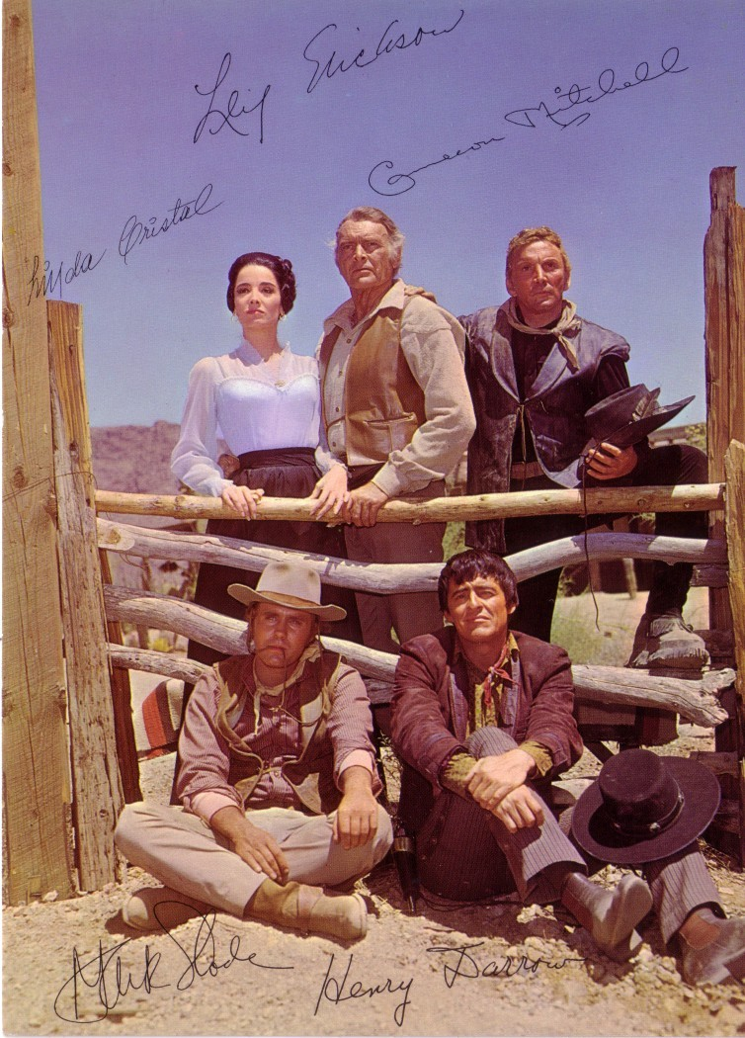
Notes:
1967-1971

Slide 27
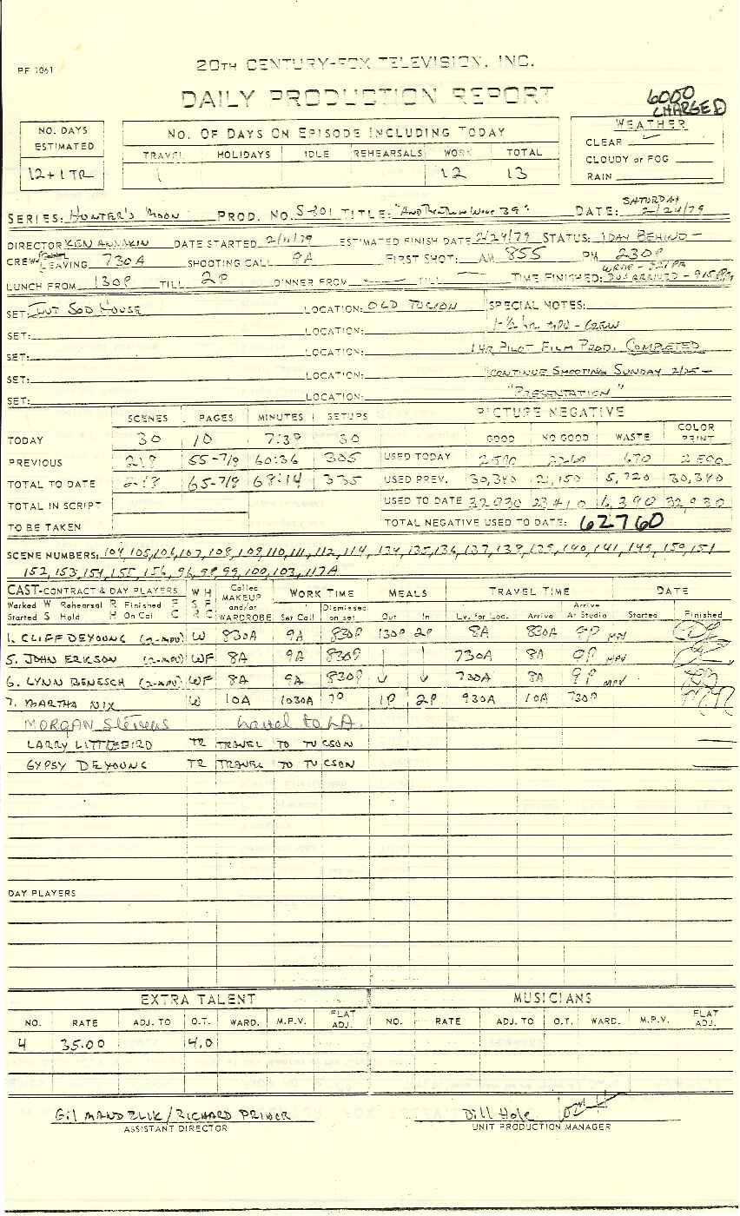
Notes:
What’s in the Dortort Archives
1979

Slide 28
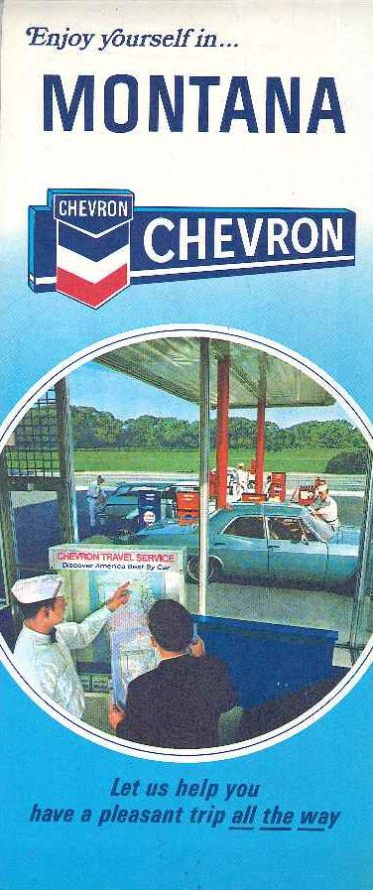
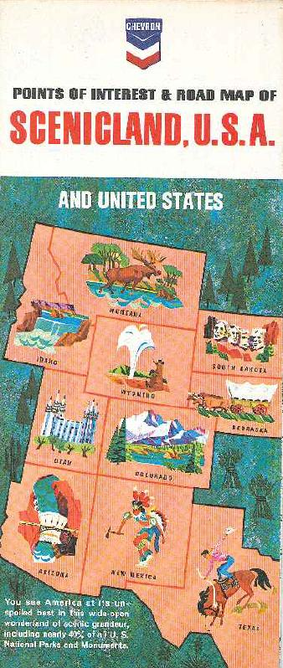

Slide 29
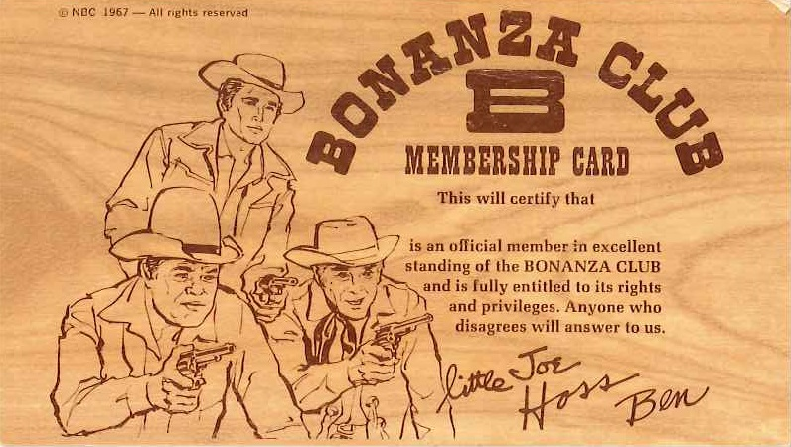
Notes:
Unlike Roy and Dale, Dortort Archives came with a donor request to restrict access to fan names and addresses.
-The fan correspondence in this collection has a higher risk of exposing recent private information about individuals
-no medical details, but individual fans relate very personal thoughts about their connection with Dortort’s projects and these letters are addressed directly to Dortort
-very recent letters, primarily from adults (1990s-2000s)
-almost all fan materials generated BY fans, rather than FOR fans

Slide 30
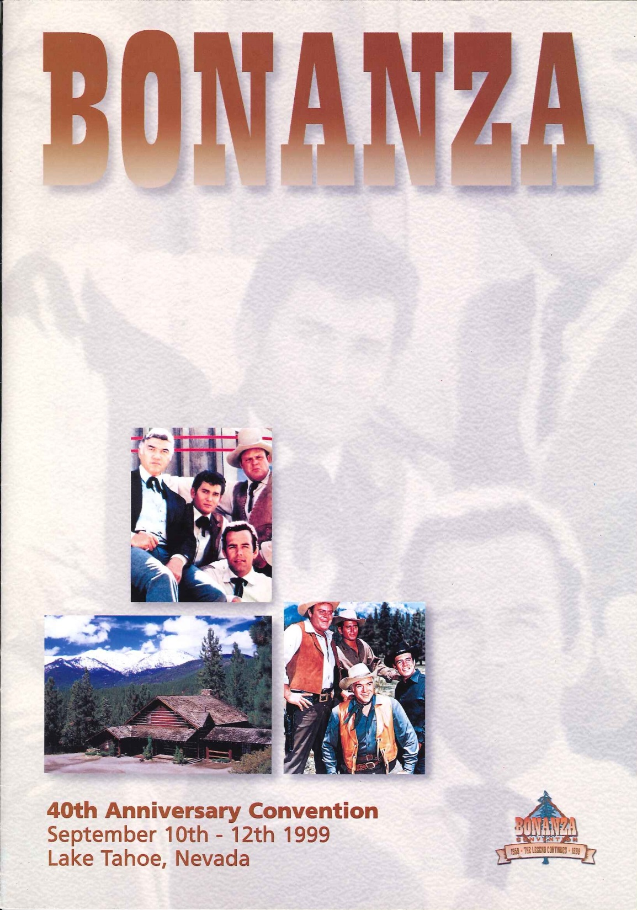
Notes:
Correspondence, recent active fan activity is reflected in archive – convention materials, fan correspondence, fan fiction
-gatherings/conventions are organized by the fans themselves

Slide 31
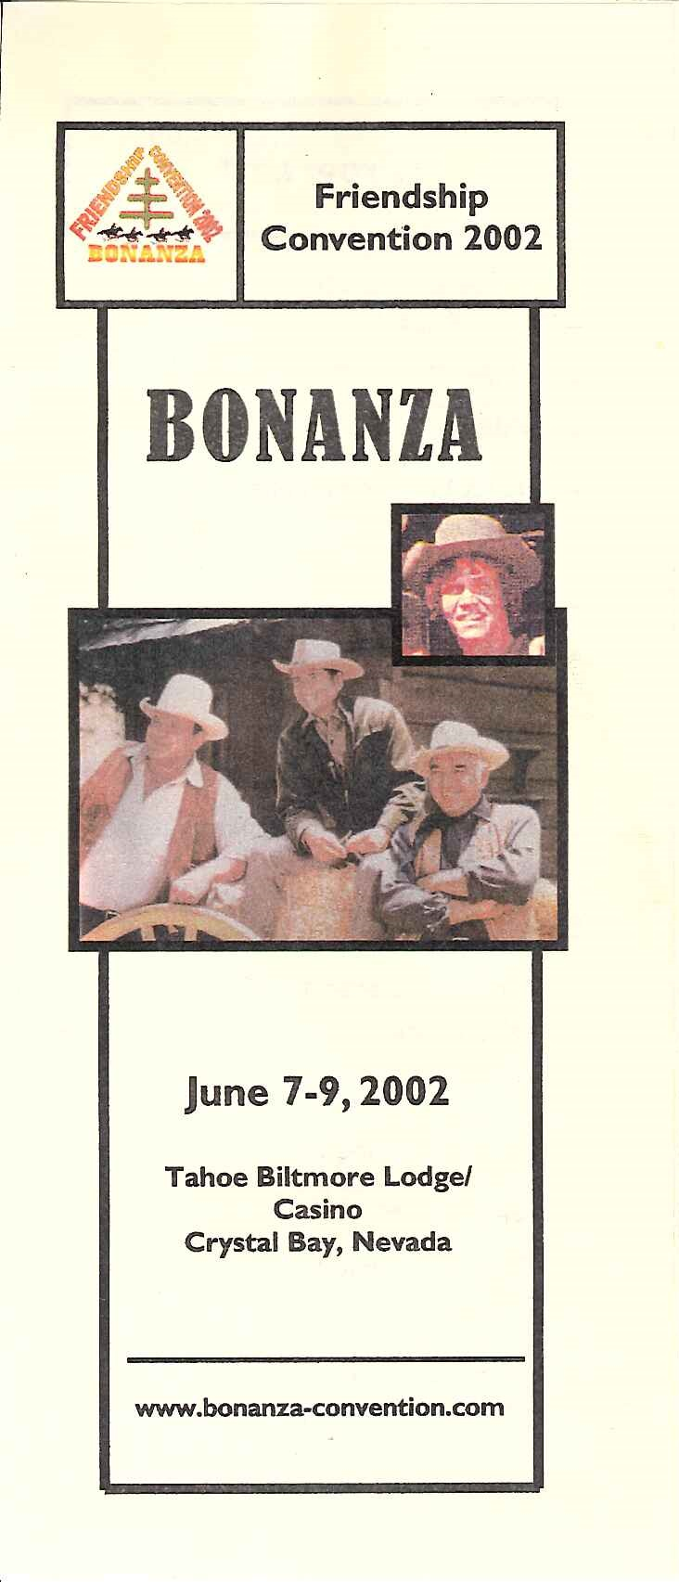
Notes:
Fan connection with programs – still an active fan community today.
-Rogers and Evans also have an active fan community, but not on the scale of the Bonanza and High Chaparral fans
-still hold fan conventions and have active online communities (High Chaparral Facebook fan page as very active)

Slide 32
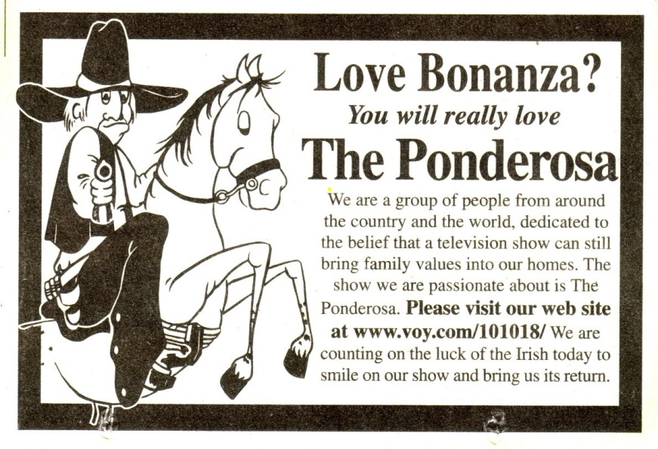
Notes:
Early 2000s campaign to stop the cancellation of Bonanza prequel The Ponderosa – this fan community bridging older analog communities and newer web 2.0 fan communities
(luck of the Irish because it was a campaign held in March)

Slide 33
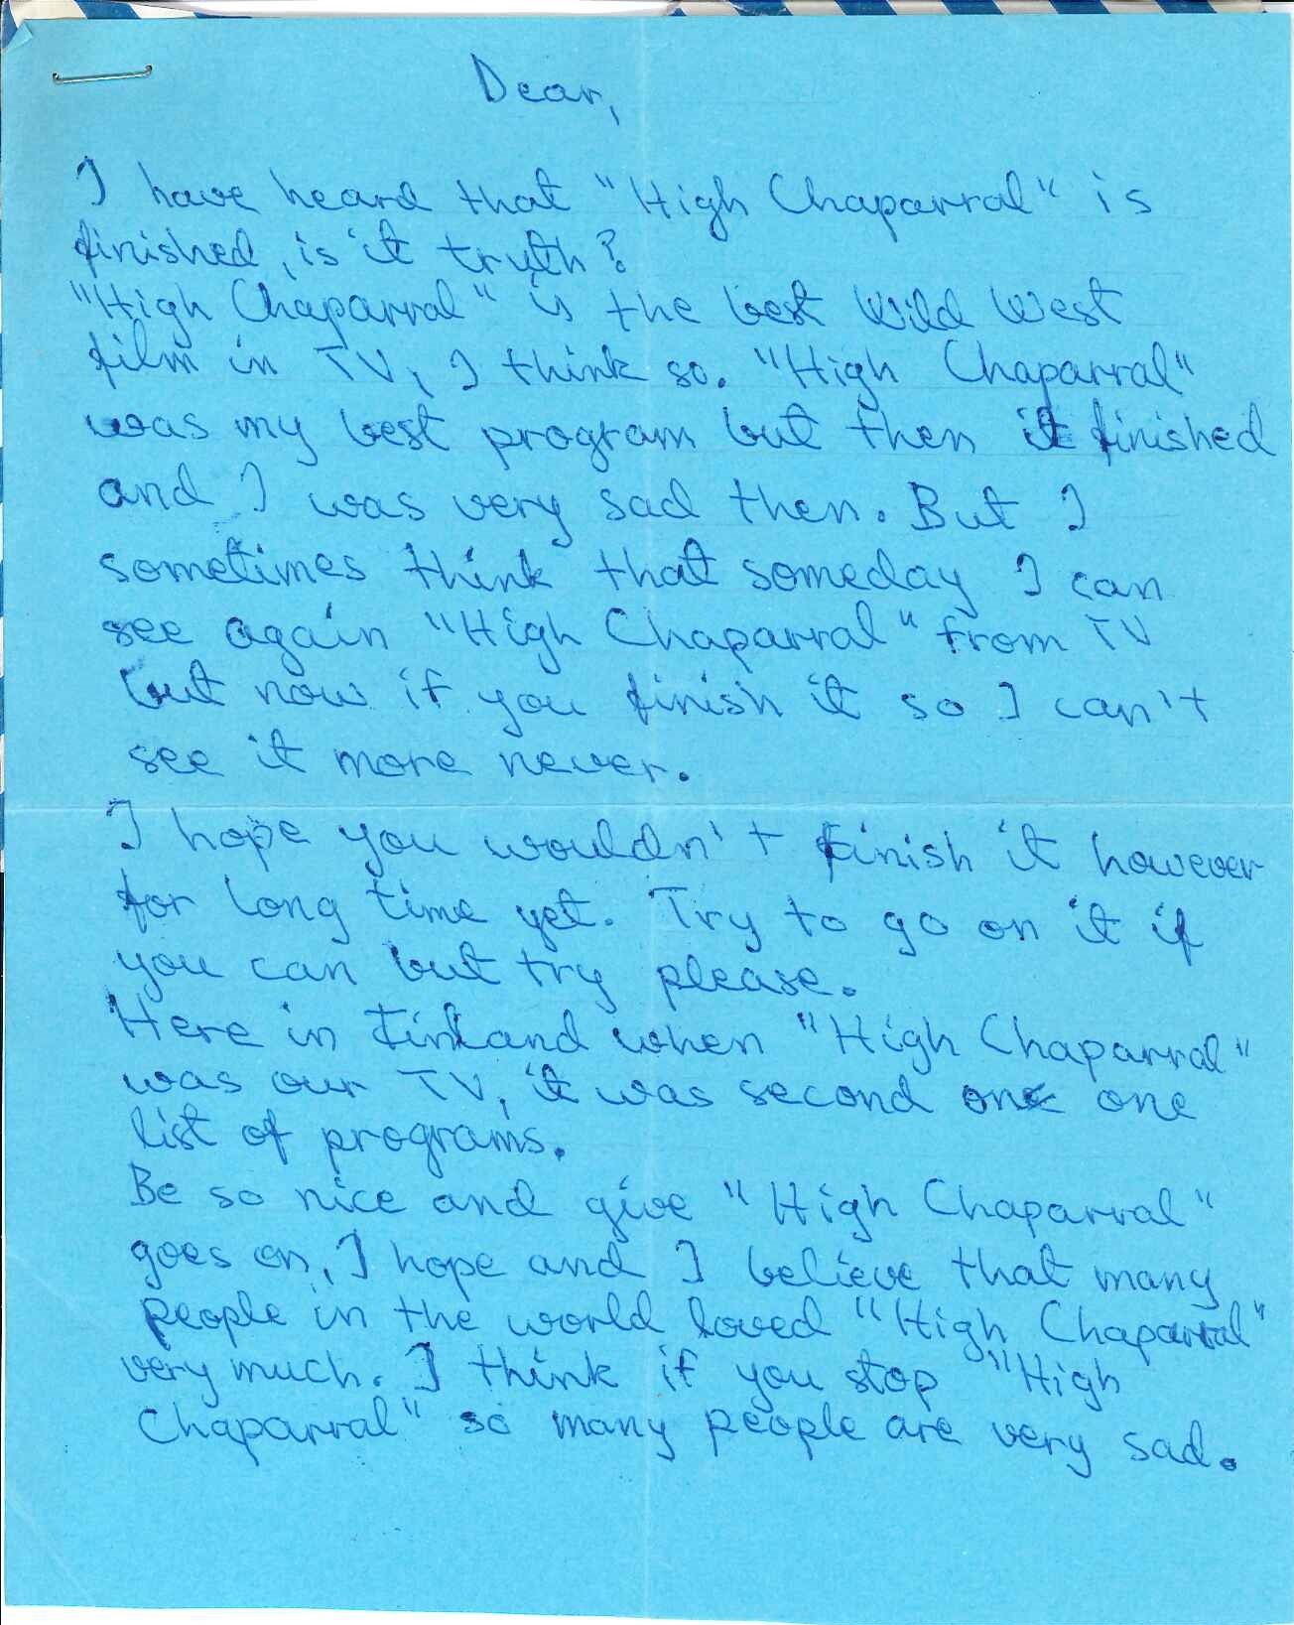
Notes:
Anonymous letter (1971 April 14) from a save The High Chaparral campaign when the series going to be cancelled
-age of the letters means it’s a lot more likely that correspondents have the same address and telephone numbers (and fan fiction – if not posted online elsewhere, is it private?)
-concerns of the donor – a verbal request, not a legally binding request, but still important to take seriously for donor relations

Slide 34
Notes:
-very few photographs, mostly correspondence with a limited amount of fan fiction and transformative art works
-personal photographs (though note scrapbook where fans basically self censored, with individual’s faces cut out for those who presumably requested not to have their image passed on anywhere) and the personal stories they shared with Dortort
-different decades, different expectations of fans about where their materials are headed?

Slide 35
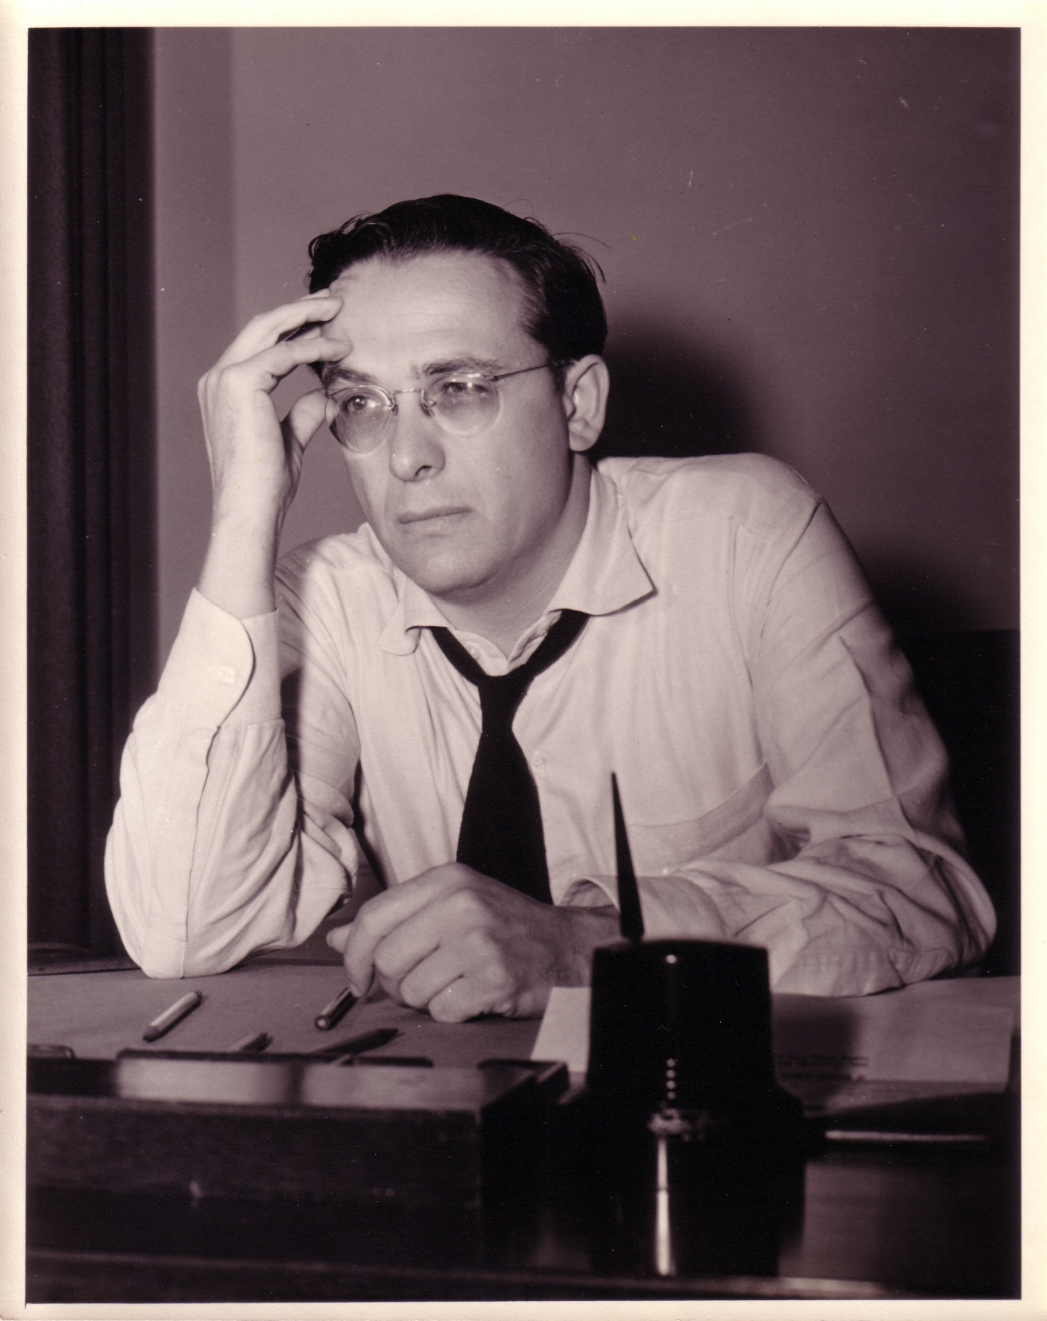
Notes:
Donor’s wishes as important – not legally part of Deed of Gift, but want to maintain good relationship with donor, as well as considering our own concerns about privacy and access to these materials
-Going to place 50 year restriction (from date of writing) on letters
-as researchers request these during this restriction period we will manually redact names and addresses by creating photocopied “access” copies
-notes in finding aid in Archivist Toolkit and physical note in applicable folders to notify anyone pulling a box for a researcher

